Slide 1
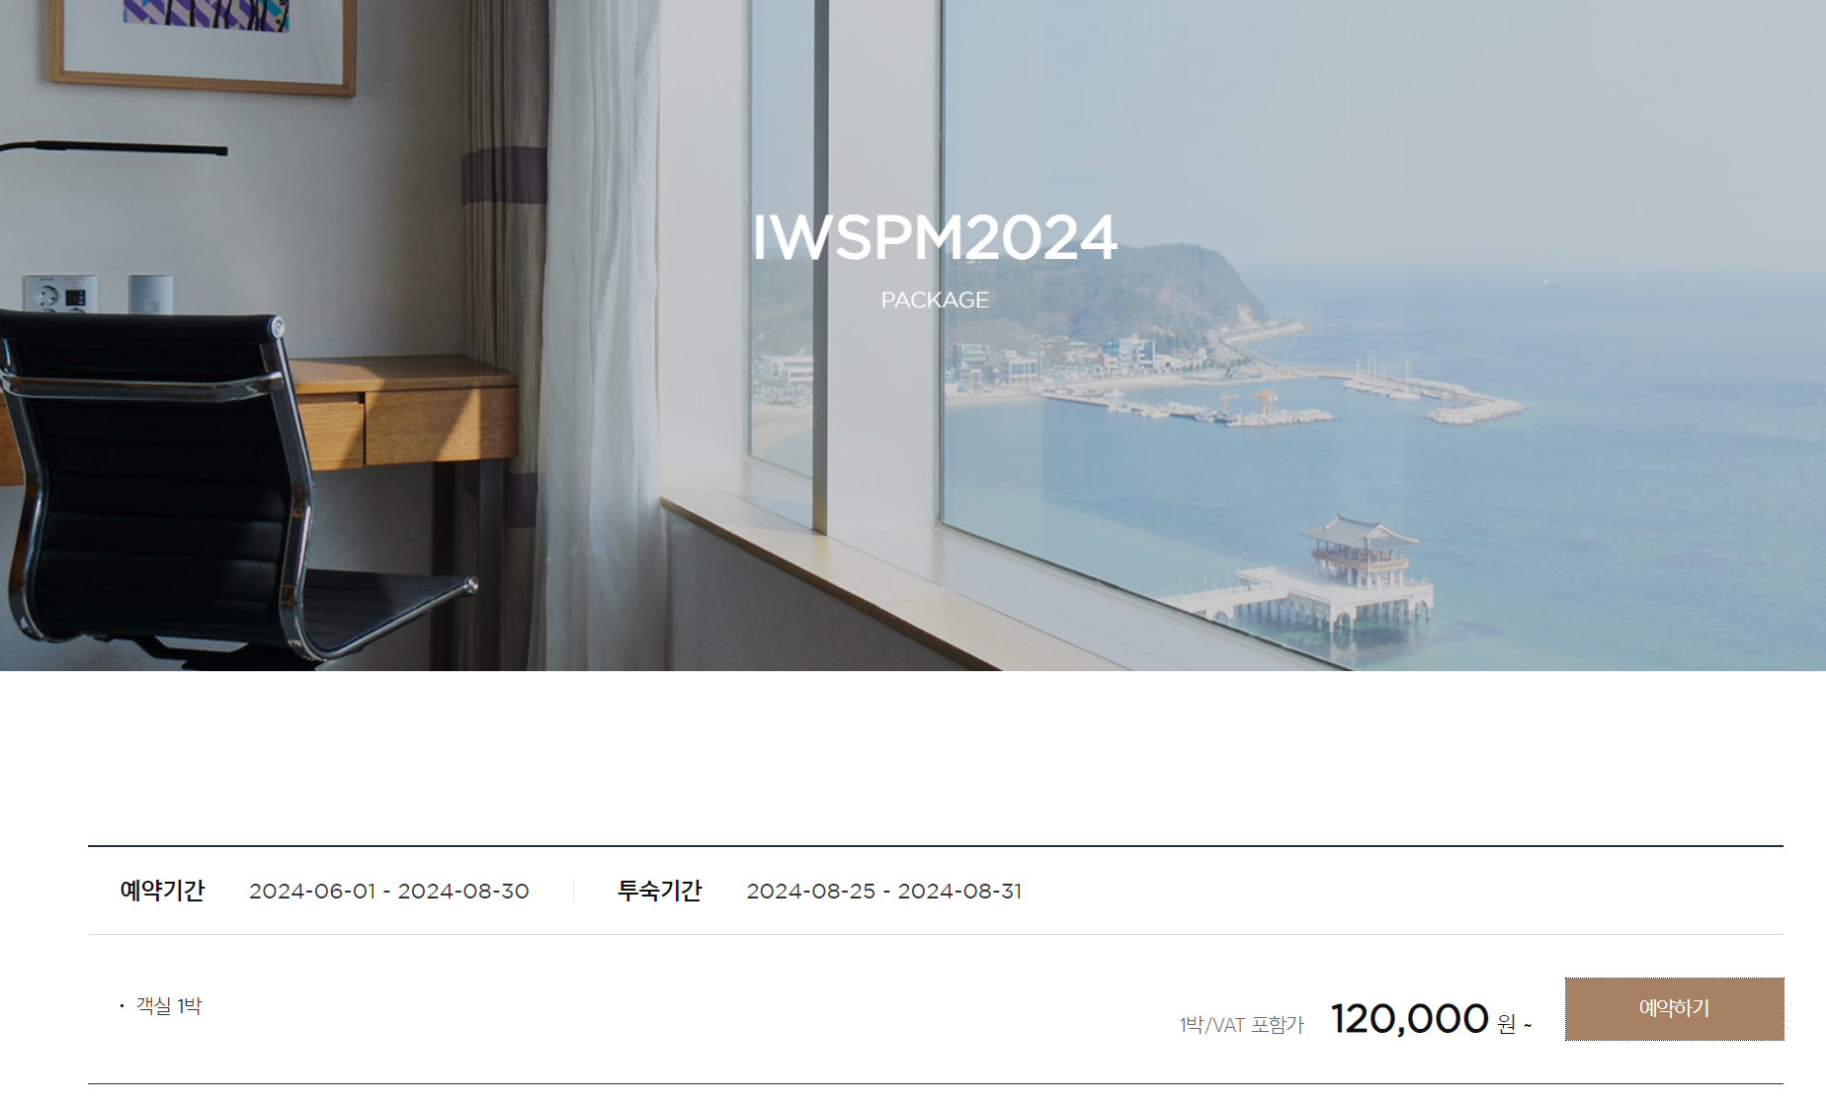
<Lahan hotel IWSPM2024 booking>
English Homepage link [CLICK]
한글버전 홈페이지 링크 [CLICK]
click

Slide 2
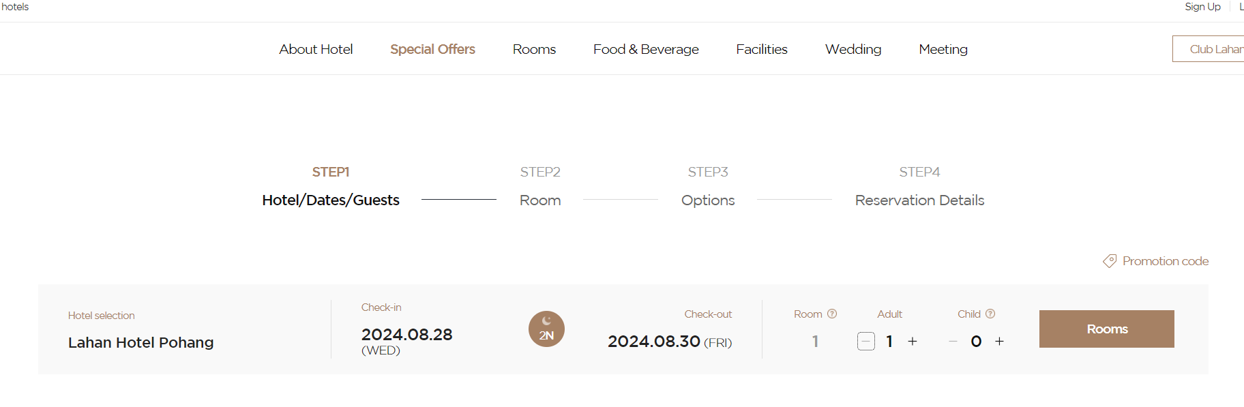
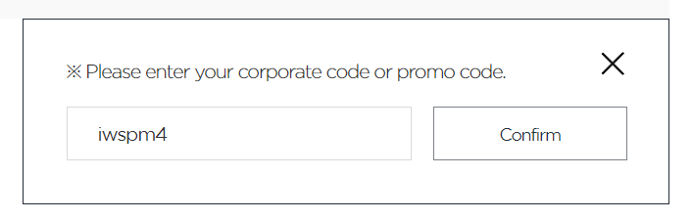
2. Promo code: iwspm4
3. click
1. Provide booking info

