Slide 1
Focus research program on nuclear mass table with DRHBc theory: even Z and odd N case
Youngman Kim/ IBS

Slide 2
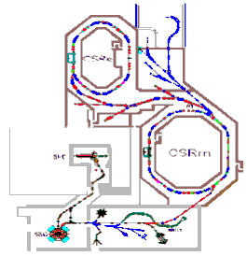
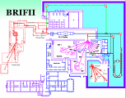
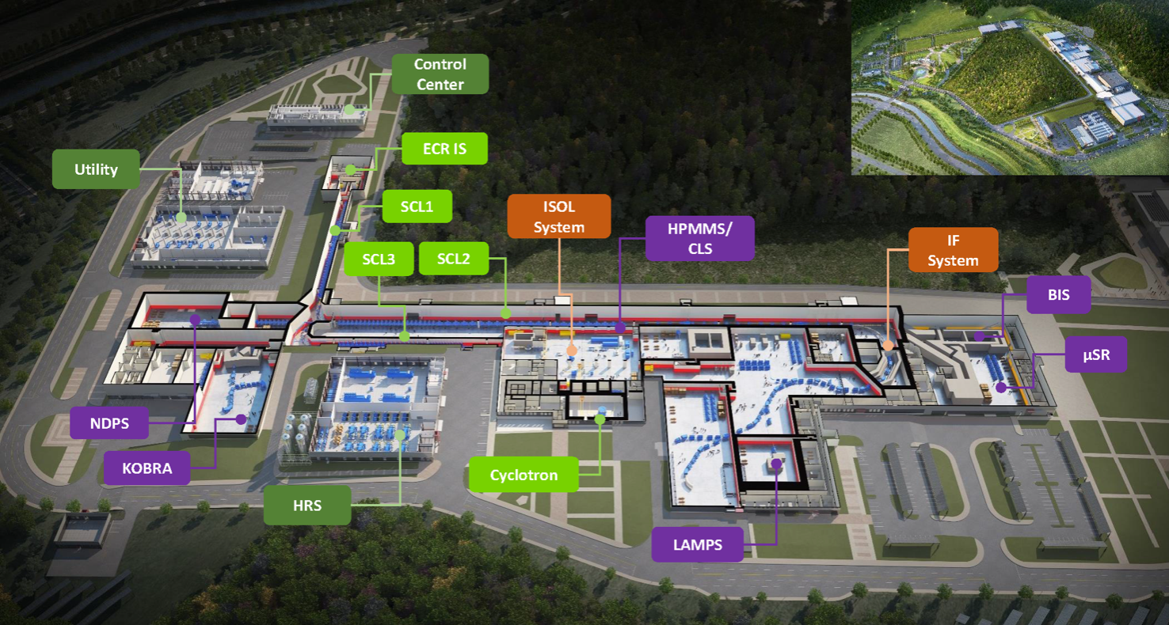

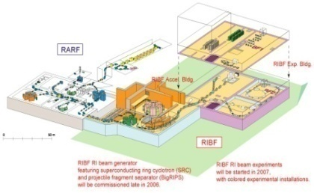
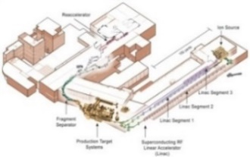
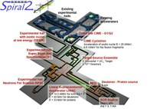
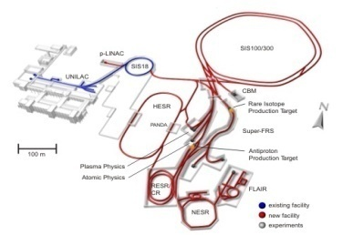

Facilities for Rare Isotope Beams
HIRFL-CSR
China
BRIF-II
China
RAON
Korea
RIKEN-RIBF
Japan
MSU-FRIB
USA
SPIRAL-II
Europe
GSI-FAIR
Germany
HIAF
China

Slide 3
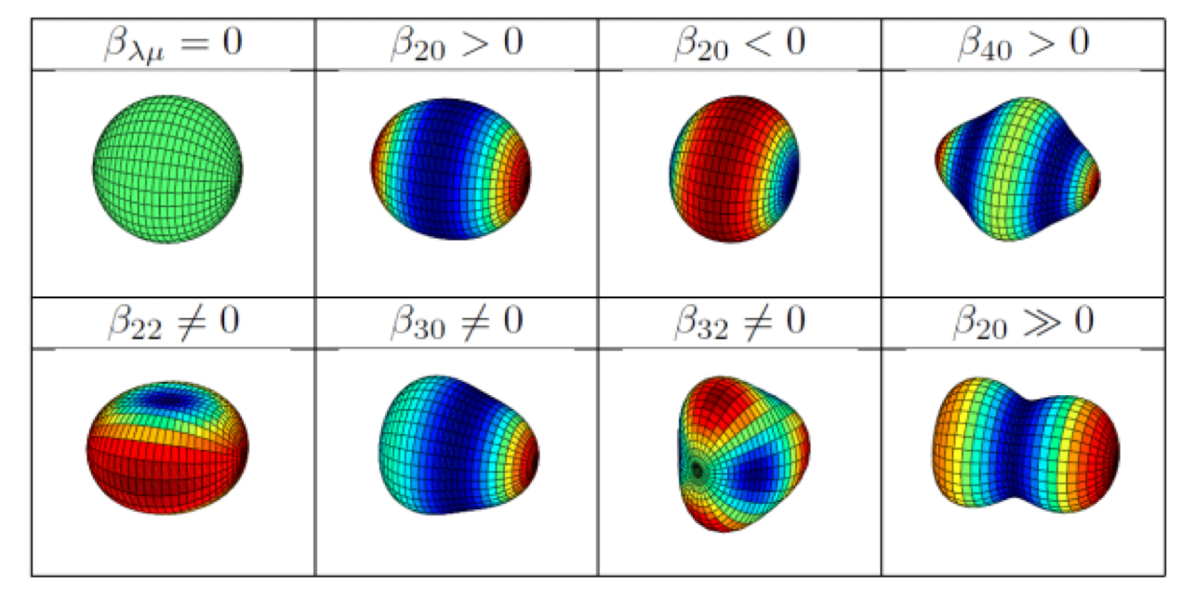

Deformed RHB theory in continuum (DRHBc)
Goal
Describe bound states, continuum, and the coupling between them
asymptotical density
deformation effect in a self-consistent and proper way
DRHBc
Based on relativistic mean field theory with axial symmetry
deformed Dirac spinors are expanded
in a basis of spherical Dirac wave functions
which are obtained from the solution of the Dirac equations
for a spherical Woods-Saxon type potential.

Slide 5
To appear in ADNDT soon

Slide 6
Collaboration Members
Korean Institues | RISP/IBS, CENS/IBS | Soongsil University Pusan National University
Chinese Institutes | Peking University Huzhou University University of Hong Kong, Beihang University ITP/CAS Nanhang University | Anhui University Sichuan Normal University Zhengzhou University IMP/CAS Southwest University

Slide 7
Topics to be discussed
Blocking effects and dripline physics for odd-A nuclei
Beyond mean field approximation such as functional renormalization group equation, etc.
DRHBc mass table (even-odd): progress and perspective
Progress reports from Korean institutes
Progress reports from Chinese institutes
Application of DRHBc with DJBUU and to other nuclear reactions

Slide 8
Blocking effects for odd-A and odd-odd nuclei
In a nutshell: pairing occurs near the Fermi surface. In the case of odd nuclei, there exists an unpaired nucleon which is inert when it comes to pairing phenomena. The state occupied by the unpaired nucleon is blocked in the sense that the state does nothing for pairing correlations. Therefore when we calculate the paring energy, etc, we need to exclude the blocked state.

Slide 9
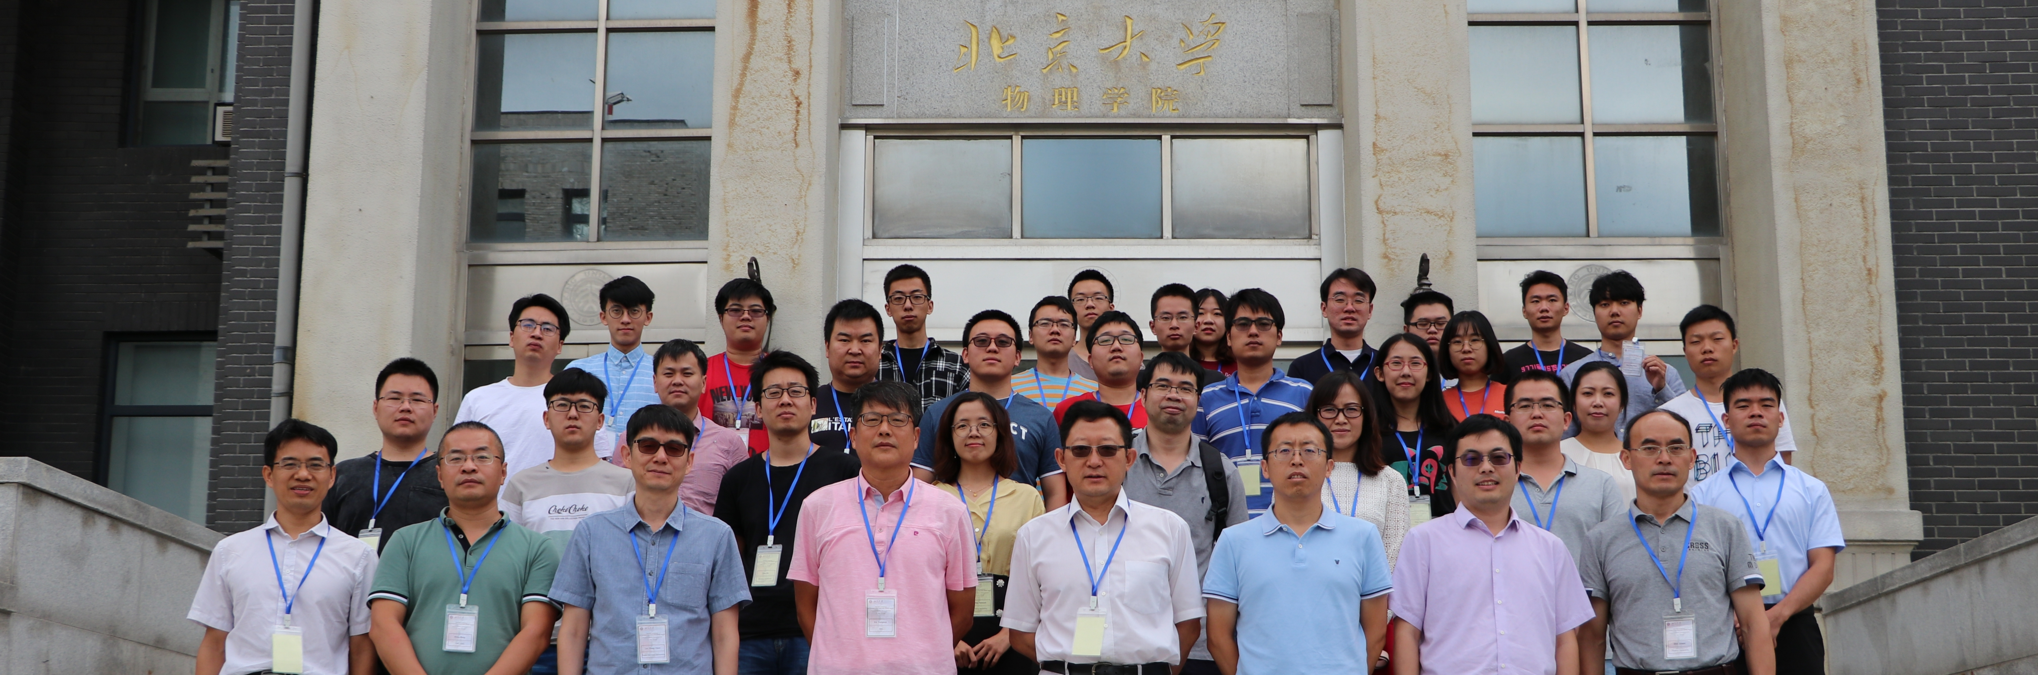
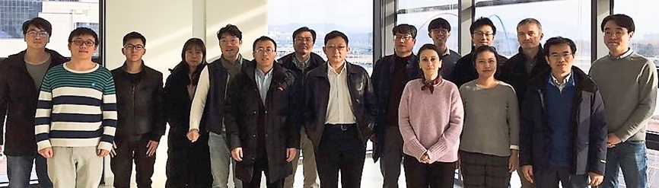
1st workshop, Daejeon, Korea
2nd workshop, Beijing, China
3rd hybrid workshop, Pusan, Korea
4th Hybrid workshop, Asan and Beijing
2nd DRHBc
1st DRHBc
Dec. 4-8, 2018
Aug. 21-24, 2019
Aug. 26-28, 2020
Dec. 16-18, 2021

Slide 10
Plan for this year
Focused collaboration meeting for a week and 5th DRHBc workshop for three days in this fall.

