Slide 1
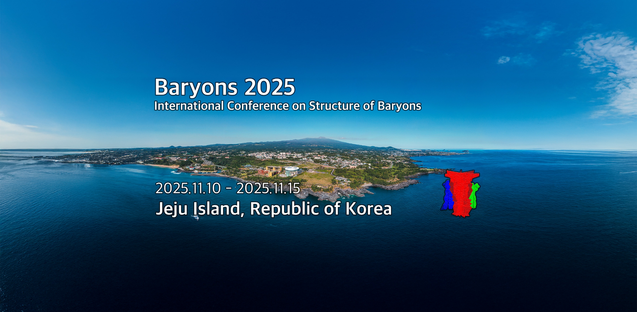
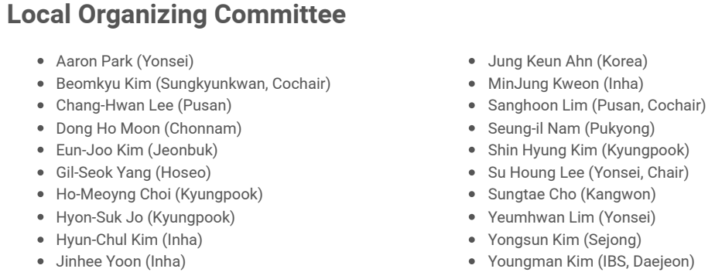
Main Organizer: Su Houng Lee(Yonsei), Beomkyu Kim(Sungkyunkwan), Sanghoon Lim(Pusan)

Slide 2

History of Baryon conference
1970: Duke University
Every 3 or 4 years
Recent: 2013 (Glasgow), 2016 (Tallahassee), 2022 (Seville)
Some stories about Baryon 2025: proposal at 2022

Slide 3
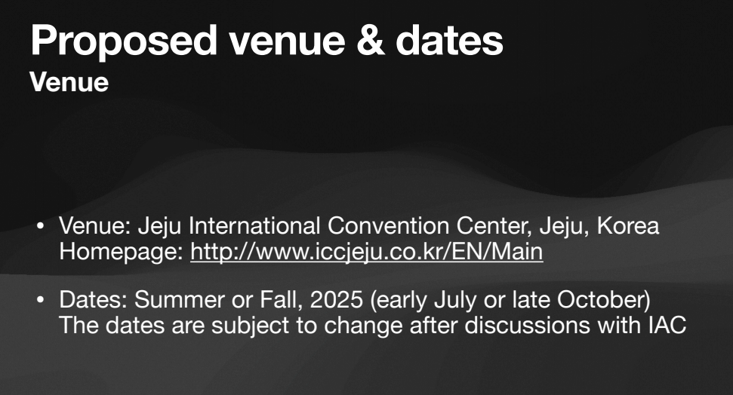

Slide 4
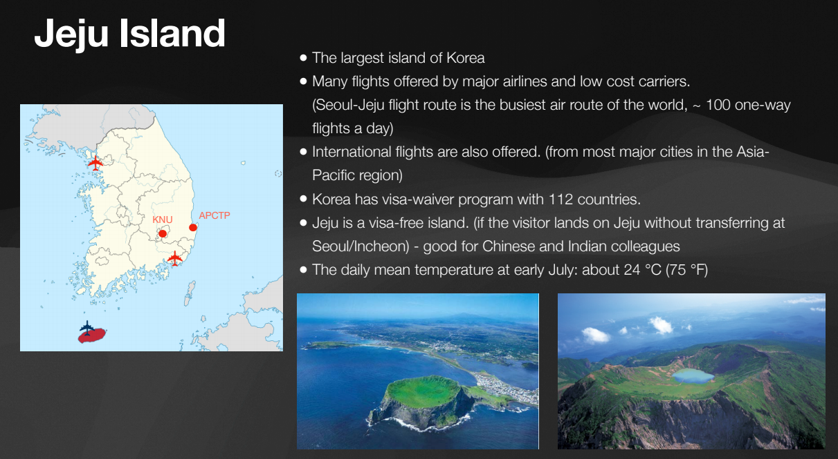

Slide 5
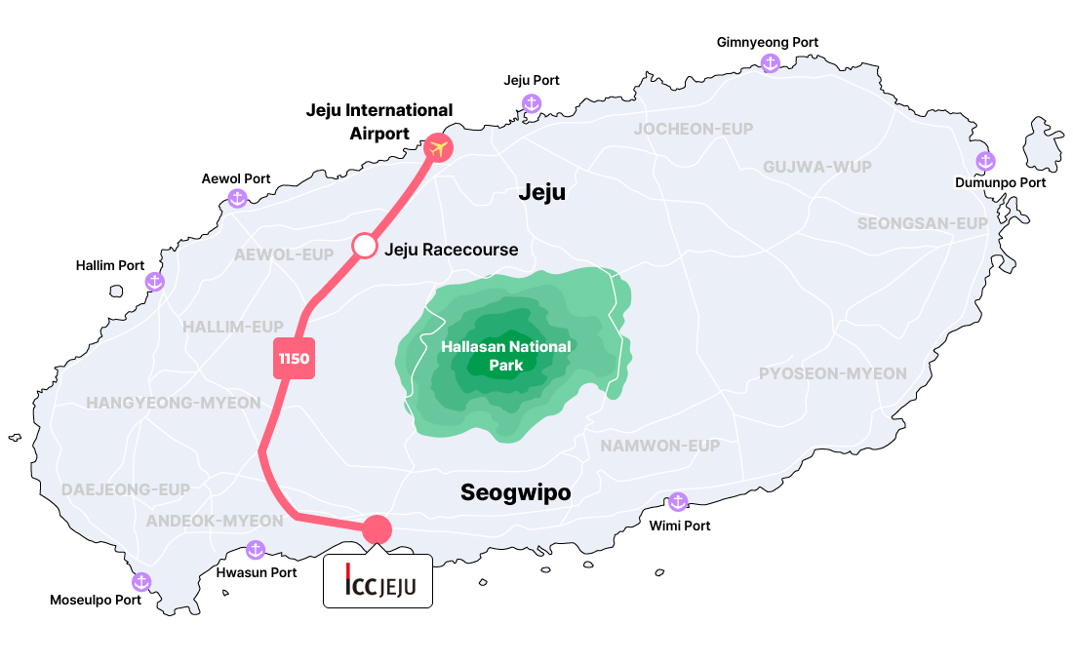
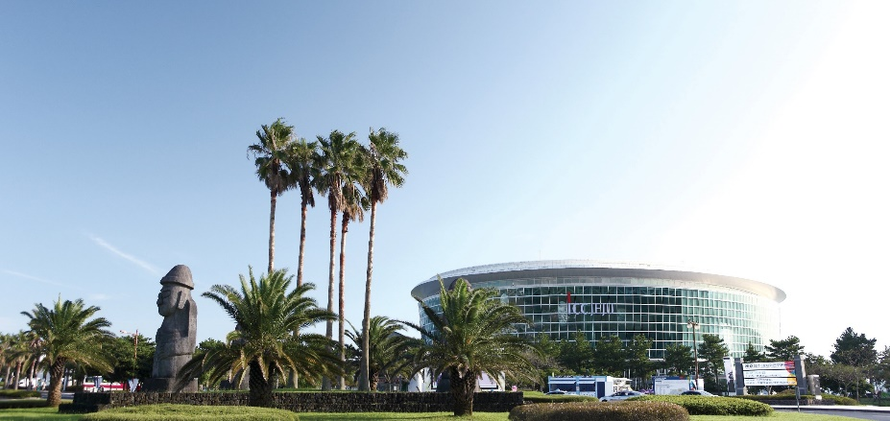
International Convention Center (ICC) Jeju

Slide 6
Registration fee will pay for
Conference halls, Lunch, Coffee breaks, reception, technical support and equipment, some transportation, miscellaneous
Based on 150-200 Participants
Registration fee
Regular: 550 USD / 800,000 KRW
Students: 450 USD / 650,000 KRW
- Banquet: separate around 80 dollars

Slide 7
Main topic
Spectroscopy of hadrons.
Hadron-hadron Interactions
Electromagnetic and weak interactions.
Hadrons at finite density and temperature.
Hadrons from heavy-ion collisions.
Exotic hadrons
Structure of hadrons.
Theory for strong QCD.
New facilities and instrumentation.
New in this conference
Inputs from LOC and others
Proceeding and awards
Journal of Subatomic Particles and Cosmology (JSPC)
- On-line Journal, Hybrid type
JSPC will provide best presentation award (500 Euro)
- Best presentation or Best Poster or Best Young Researcher
- Theory and/or Experiment

Slide 8
Plenary talks
Recommendation from IAC
IAC and LOC will Adjust balance: Regional+ Gender+
Parallel talks; IAC will choose two topics and vote
Spectroscopy of hadrons.
Hadron-hadron Interactions
Electromagnetic and weak interactions.
Hadrons at finite density and temperature.
Hadrons from heavy-ion collisions.
Exotic hadrons
Structure of hadrons.
Theory for strong QCD.
New facilities and instrumentation.

Slide 9

Sponsors: more are welcome
-Institute for Nonperturbative Physics/Nanjing
-Asia Pacific Center for theoretical physics/APCTP
-JSPC/Elsevier
-Korea tourism center
-Korea-Alice
- More are welcome

Slide 10
Suggestions/comments
Next Baryon

Slide 11
Program
Method used
 | Mon | Tues | Wed | Thur | Fri
AM | Plenary | 4 Parallel | Plenary | 4 Parallel | Plenary
PM | Plenary | 4 Parallel | Excursion | 4 Parallel | Plenary
Evening | Reception | Poster | IAC | Banquet

