Slide 1
Physics of Exited hadrons in the Present and Future Facilities
Searching for exotics in multi-pion photoproductions: focusing on the role of hybrid mesons in tensor meson photoproductions
B.-G. Yu* & K.-J. Kong
Korea Aerospae Univ.
14th APCTP-BLTP Joint Workshop
July 11, 2023, APCTP, Pohang

Slide 2
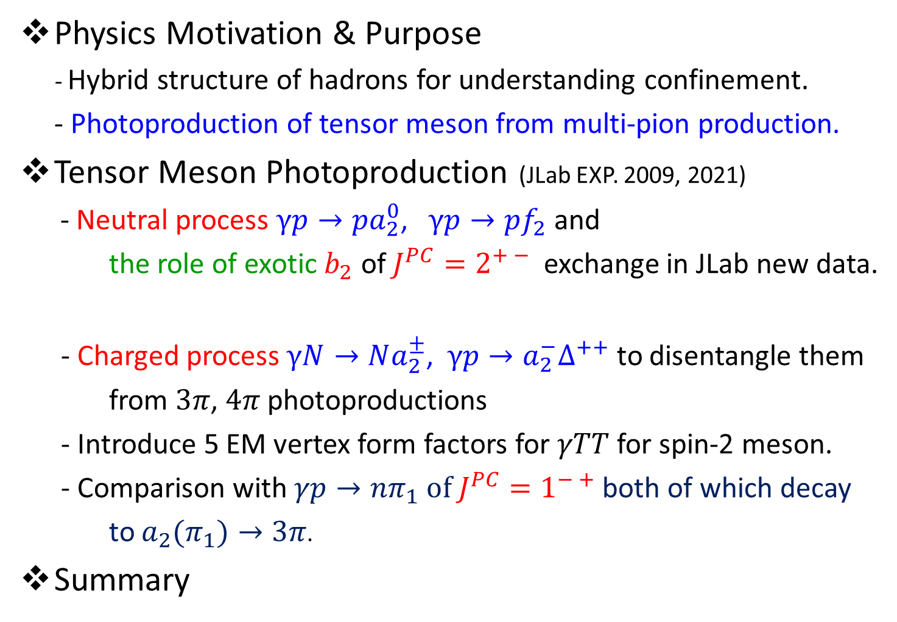
Outline
Physics Motivation & Purpose
- Hybrid structure of hadrons for understanding confinement.
- Photoproduction of tensor meson from multi-pion production.
Tensor Meson Photoproduction (JLab EXP. 2009, 2021)
- Neutral process $γp→pa_{2}^{0}$, $γp→pf_{2}$ and
the role of exotic $b_{2}$ of $J^{PC}=2^{+ −}$ exchange in JLab new data.
- Charged process $γN→Na_{2}^{±}$, $γp→a_{2}^{−}∆^{++}$ to disentangle them
from $3π$, $4π$photoproductions
- Introduce 5 EM vertex form factors for $γTT$ for spin-2 meson.
- Comparison with $γp→nπ_{1} of J^{PC}=1^{− +}$ both of which decay
to $a_{2}(π_{1})→3π$.
Summary
1/11

Slide 3
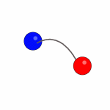

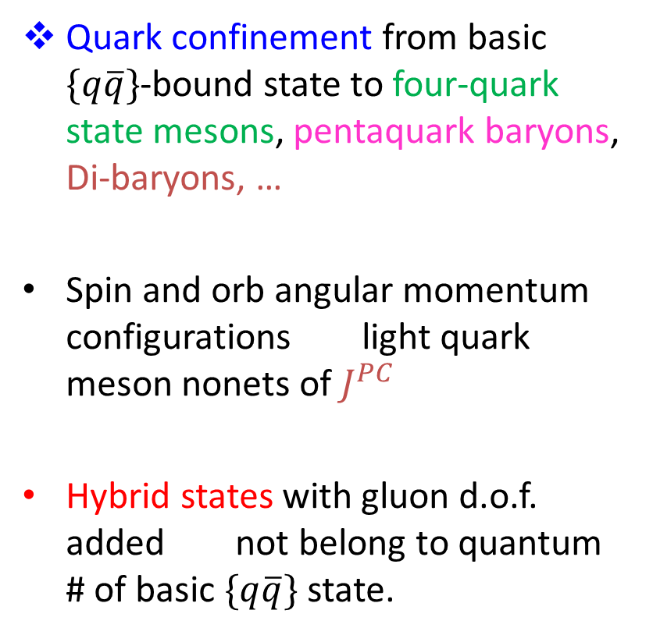


Exotic/Hybrid Mesons?
Quark confinement from basic $\{q\overline{q}\}$-bound state to four-quark state mesons, pentaquark baryons, Di-baryons, …
Spin and orb angular momentum configurations light quark meson nonets of $J^{PC}$
Hybrid states with gluon d.o.f. added not belong to quantum # of basic $\{q\overline{q}\}$state.
u
c
u
u
d
B
B
c
u
d
s
g
Meyer,Haarlem, PRC 82, 025208 (2010)
J^{PC} = 0⁺ ⁺ 0⁻ ⁺ 0⁺ ⁻ 1⁻ ⁻ 1⁺ ⁺ 1⁺ ⁻ 1⁻ ⁺ 2⁺ ⁺ 2⁻ ⁺ 2⁺ ⁻
$$b_{0}(h_{0})$$
$$π_{1}$$
$$b_{2}(h_{2})$$
All hybrids are natural (Naturality: $P{(−)}^{J}=±$ for $J^{PC}$)

Slide 4
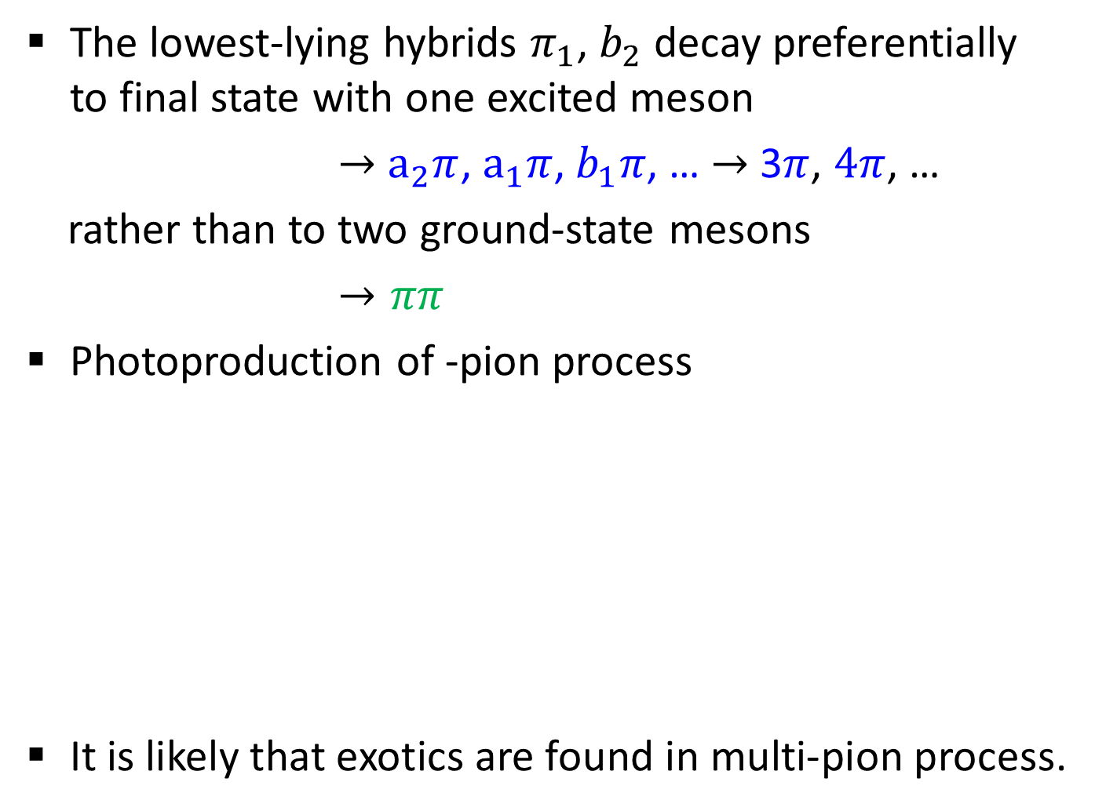

Why they are missing and where to find them?
Isgur, Kokoski, Paton, PRL 54, 869 (1985)
The lowest-lying hybrids $π_{1}$, $b_{2}$ decay preferentially to final state with one excited meson
$→$ $a_{2}π$, $a_{1}π$, $b_{1}π$, … $→$ 3$π$, $4π$, …
rather than to two ground-state mesons
$→ππ$
Photoproduction of -pion process
It is likely that exotics are found in multi-pion process.
Condo et. Al. PRD 41, 3317 (1990)
$$γN→Na_{2}^{±}→Nπππ$$
$$γp→∆^{++}a_{2}^{−}→(pπ)a_{2}→(pπ)πππ$$
$$γN→Nπ_{1}^{±}→Nπππ$$
Notes:
E852 2600,000 events no evidence for pi1? Controversial?

Slide 5
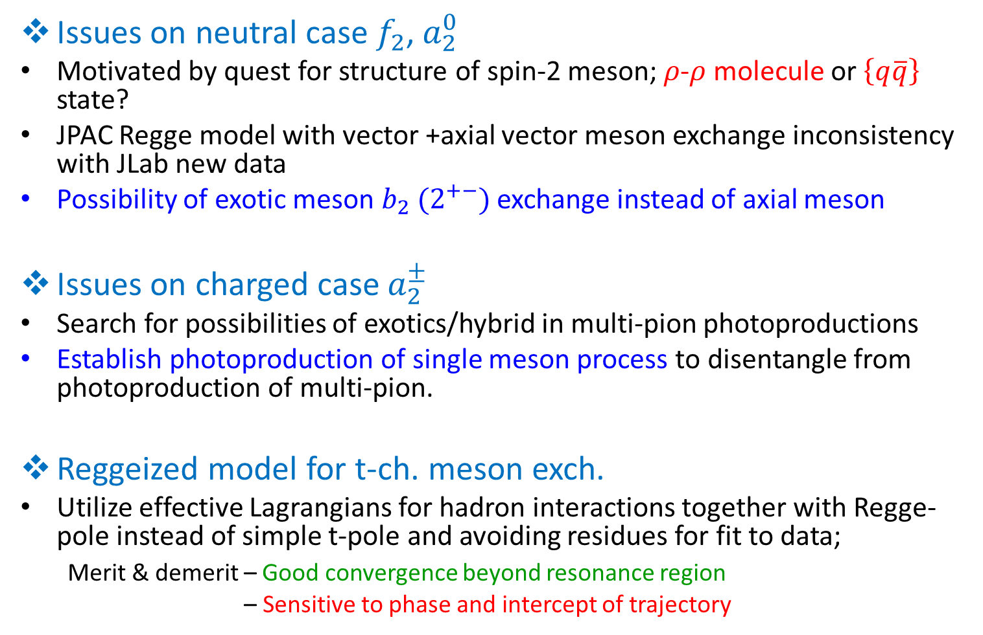
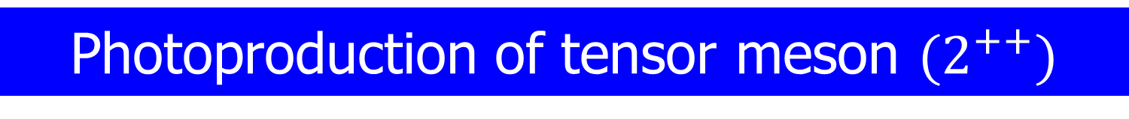
Photoproduction of tensor meson ${(2}^{++})$
Issues on neutral case $f_{2}$, $a_{2}^{0}$
Motivated by quest for structure of spin-2 meson; $ρ$-$ρ$ molecule or $\left\{q\overline{q}\right\}$ state?
JPAC Regge model with vector +axial vector meson exchange inconsistency with JLab new data
Possibility of exotic meson $b_{2} {(2}^{+−})$ exchange instead of axial meson
Issues on charged case $a_{2}^{±}$
Search for possibilities of exotics/hybrid in multi-pion photoproductions
Establish photoproduction of single meson process to disentangle from photoproduction of multi-pion.
Reggeized model for t-ch. meson exch.
Utilize effective Lagrangians for hadron interactions together with Regge-pole instead of simple t-pole and avoiding residues for fit to data;
Merit & demerit – Good convergence beyond resonance region
– Sensitive to phase and intercept of trajectory

Slide 6
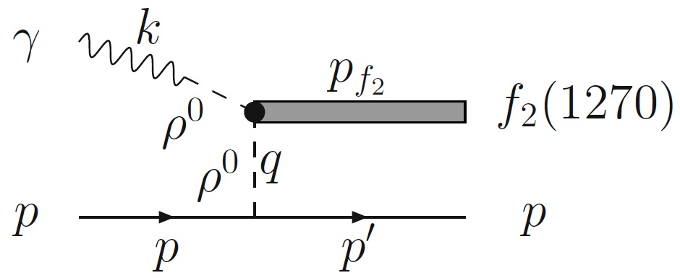
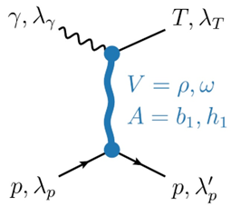
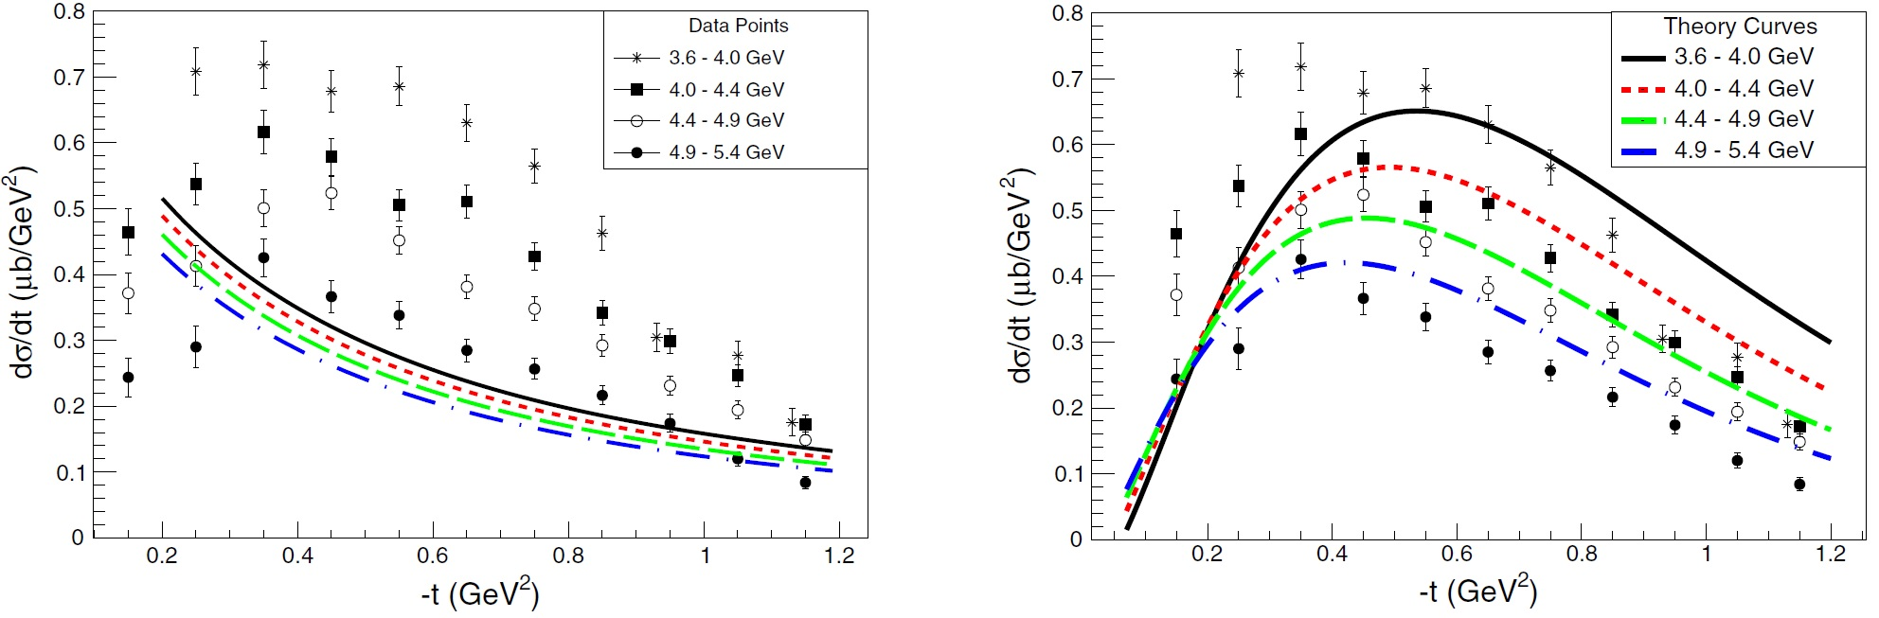
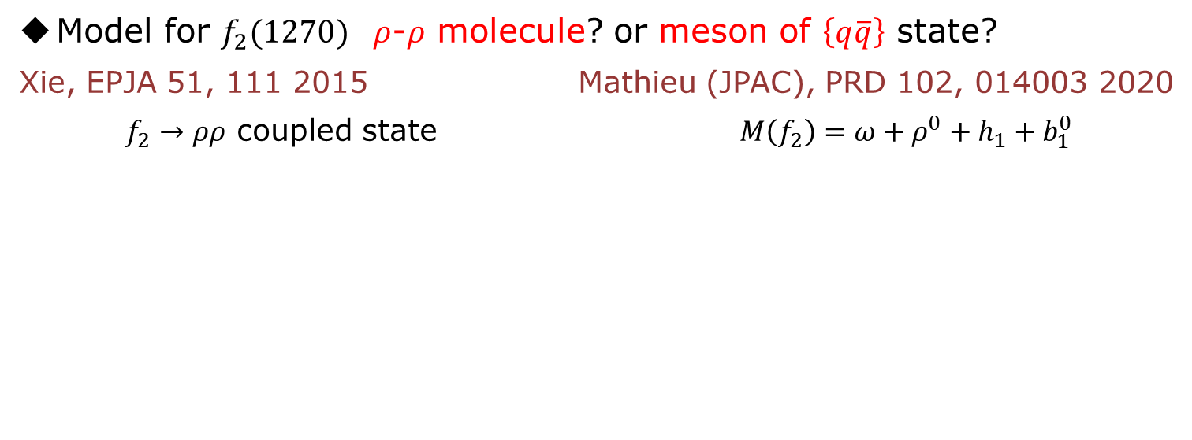
Current status of $f_{2}$ & $a_{2}^{0}$ photoproductions
Model for $f_{2}(1270)$ $ρ$-$ρ$ molecule? or meson of $\left\{q\overline{q}\right\}$ state?
Xie, EPJA 51, 111 2015 Mathieu (JPAC), PRD 102, 014003 2020
$f_{2}→ρρ$ coupled state $M\left(f_{2}\right)=ω+ρ^{0}+h_{1}+b_{1}^{0}$
Carver, PRL 126, 082002 2021
Inconsistency with g12 data
Scaled by 0.6 factor

Slide 7
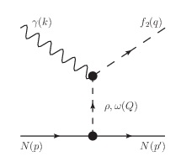

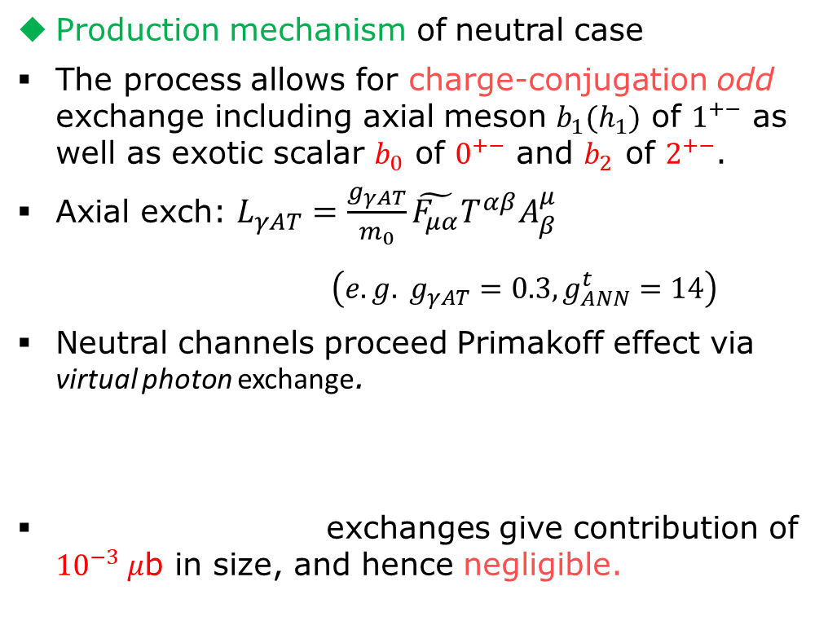


Production mechanism of neutral process
Production mechanism of neutral case
The process allows for charge-conjugation odd exchange including axial meson $b_{1}(h_{1})$ of $1^{+−}$ as well as exotic scalar $b_{0}$ of $0^{+−}$ and $b_{2}$ of $2^{+−}$.
Axial exch: $L_{γAT}=\frac{g_{γAT}}{m_{0}}\tilde{F_{μα}}T^{αβ}A_{β}^{μ}$
$\left(e.g. g_{γAT}=0.3, g_{ANN}^{t}=14\right)$
Neutral channels proceed Primakoff effect via virtual photon exchange.
exchanges give contribution of ${10}^{−3} μ$b in size, and hence negligible.
T
$$ω+ρ^{0}+b_{2}+h_{1}+b_{1}^{0}+b_{0}+γ^{∗}$$
$$h_{1}+b_{1}^{0}+b_{0}+γ^{∗}$$
$$M=ω+ρ^{0}+b_{2}\left(1800\right)$$
$α_{J}\left(t\right)=0.9\left(t−m_{J}^{2}\right)+J$ for $φ=V, T,{ b}_{0}, π_{1}, { b}_{2}$
$α_{J}\left(t\right)=0.7\left(t−m_{J}^{2}\right)+J$ for $φ=π, A, B, H$

Slide 8
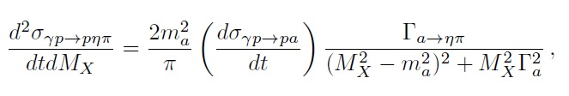
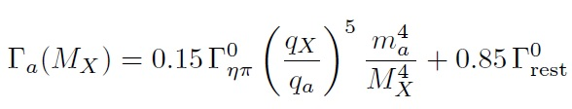

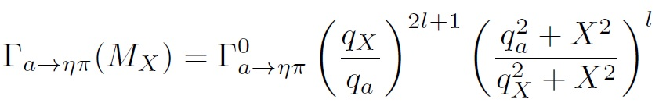
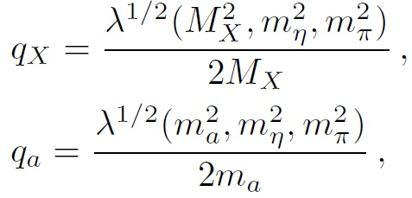
Invariant mass distribution
Invariant mass distribution with linear background
Invariant mass distribution restricts model parameters such as coupling constants, Regge phase, …

Slide 9





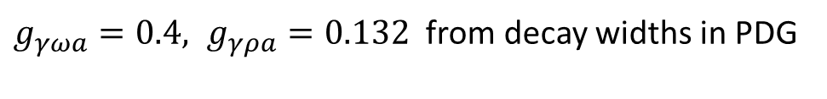
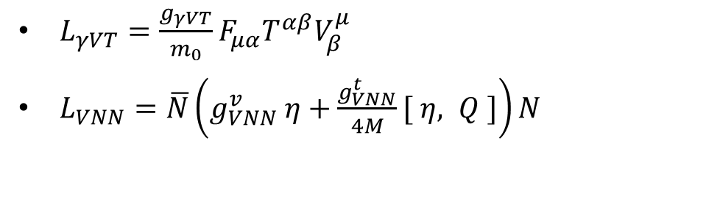



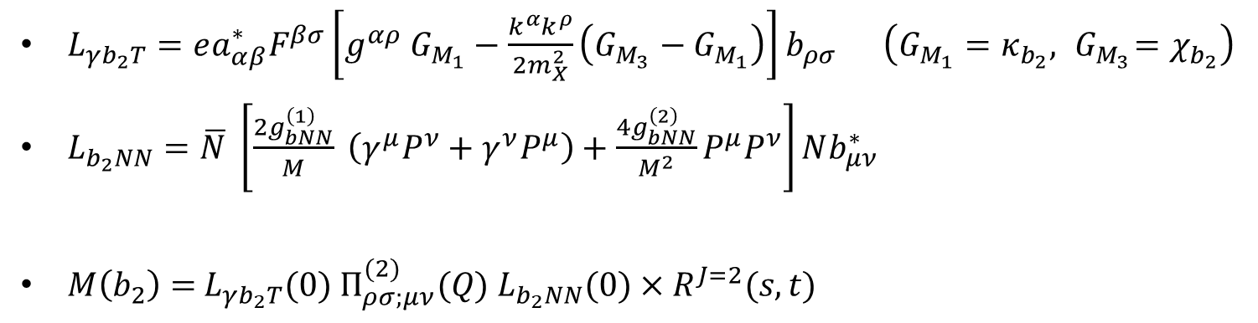
$a_{2}^{0}$photoproduction
Vector meson exchange
$$(1^{− −})$$
$a_{2}^{0}(q)$
$$(2^{+ +})$$
$L_{γVT}=\frac{g_{γVT}}{m_{0}}F_{μα}T^{αβ}V_{β}^{μ}$
$L_{VNN}=\overline{N}\left(g_{VNN}^{v} η+\frac{g_{VNN}^{t}}{4M}[ η, Q ]\right)N$
$b_{2}^{0}($
$$(2^{+ −})$$
$g_{γωa}=0.4, g_{γρa}=0.132$ from decay widths in PDG
$g_{ωNN}^{v}=15.6, { g}_{ωNN}^{t}=0; g_{ρNN}^{v}=2.6, g_{ρNN}^{t}=9.62$
Common role of exotic $b_{2}$ of $2^{+−}$ with magnetic interaction
$L_{γb_{2}T}=ea_{αβ}^{∗}F^{βσ}\left[g^{αρ} G_{M_{1}}−\frac{k^{α}k^{ρ}}{2m_{X}^{2}}\left(G_{M_{3}}−G_{M_{1}}\right)\right]b_{ρσ} \left(G_{M_{1}}=κ_{b_{2}},{ G}_{M_{3}}=χ_{b_{2}}\right)$
$L_{b_{2}NN}=\overline{N} \left[\frac{2g_{bNN}^{\left(1\right)}}{M} \left(γ^{μ}P^{ν}+γ^{ν}P^{μ}\right)+\frac{4g_{bNN}^{\left(2\right)}}{M^{2}}P^{μ}P^{ν}\right]Nb_{μν}^{∗}$
$M\left(b_{2}\right)=$ $L_{γb_{2}T}(0) Π_{ρσ;μν}^{(2)}(Q)$ $L_{b_{2}NN}(0)×R^{J=2}(s,t)$
$C$– even

Slide 10
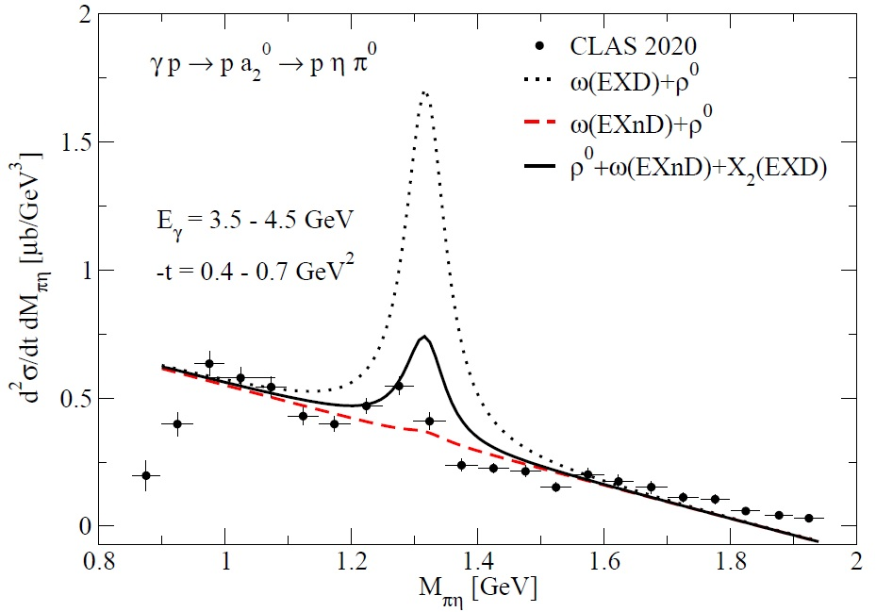
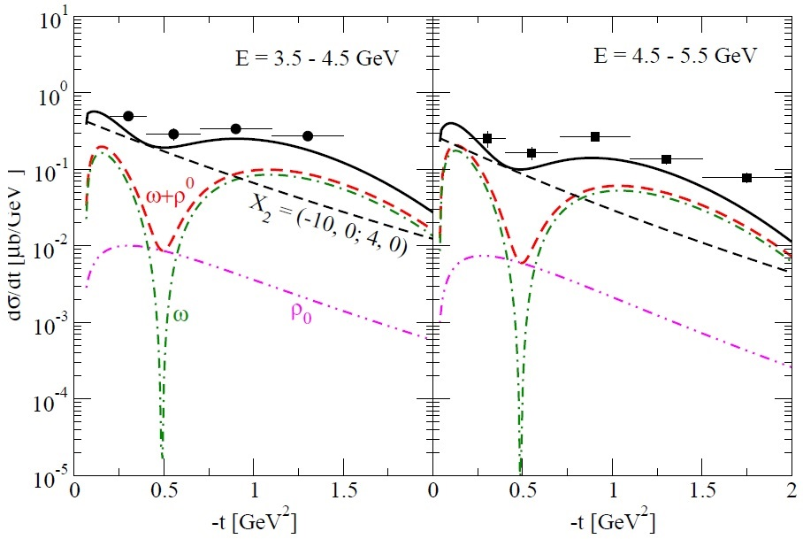



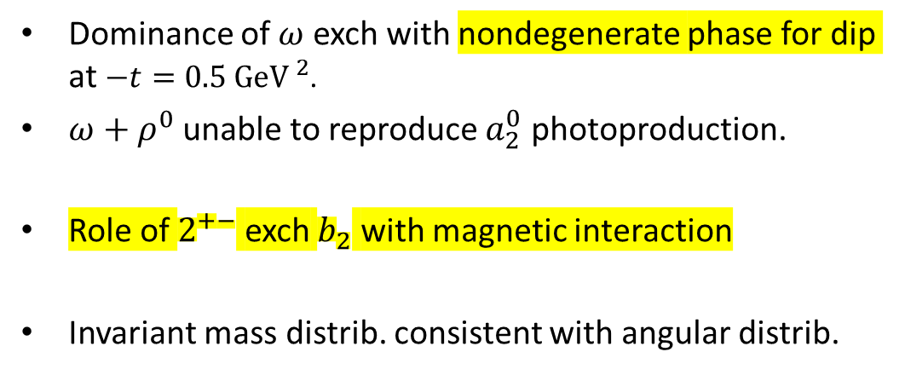


$a_{2}^{0}$photoproduction
Dominance of $ω$ exch with nondegenerate phase for dip at $−t=0.5{ GeV }^{2}$.
$ω+ρ^{0}$ unable to reproduce $a_{2}^{0}$ photoproduction.
Role of $2^{+−}$ exch $b_{2}$ with magnetic interaction
Invariant mass distrib. consistent with angular distrib.
$a_{2}^{0}(q)$
$b_{2}^{0}(Q)$
$$m_{b2}=1.8 GeV$$
$g_{b_{2}NN}^{(1)}=−10,$ $g_{b_{2}NN}^{(2)}=0; κ_{b_{2}}=4, χ_{b_{2}}=4$
Celentano, PRC 102, 032201(R) 2021
$b_{2}^{0}(EXD)$

Slide 11
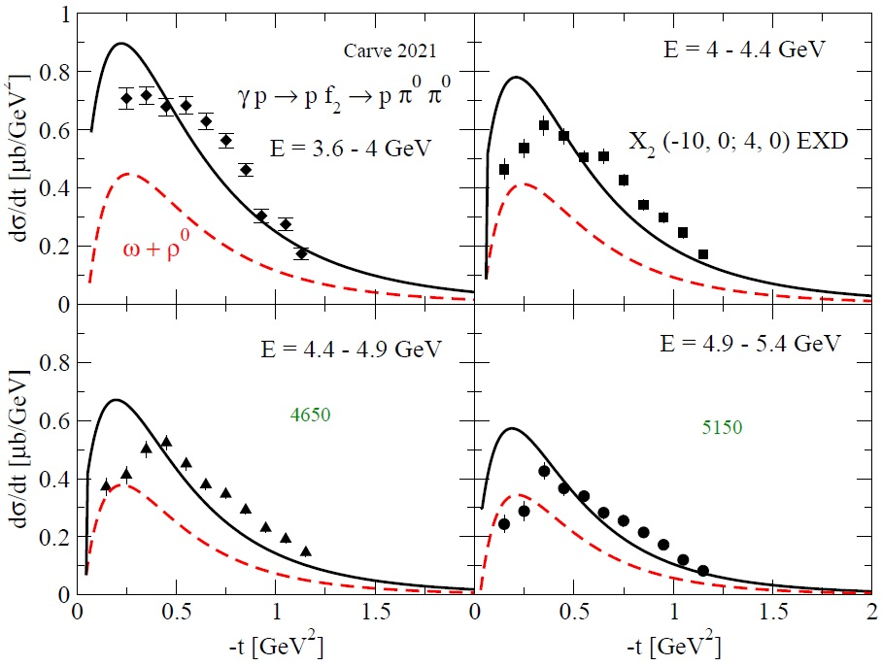
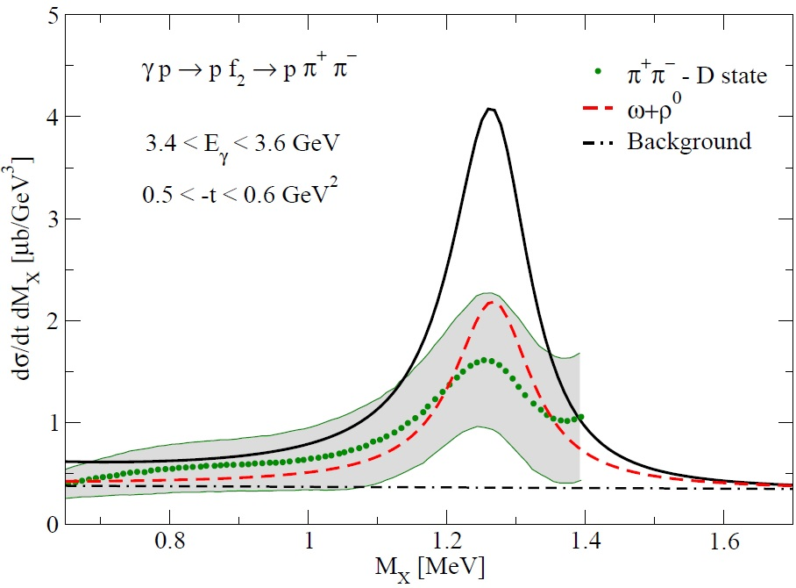
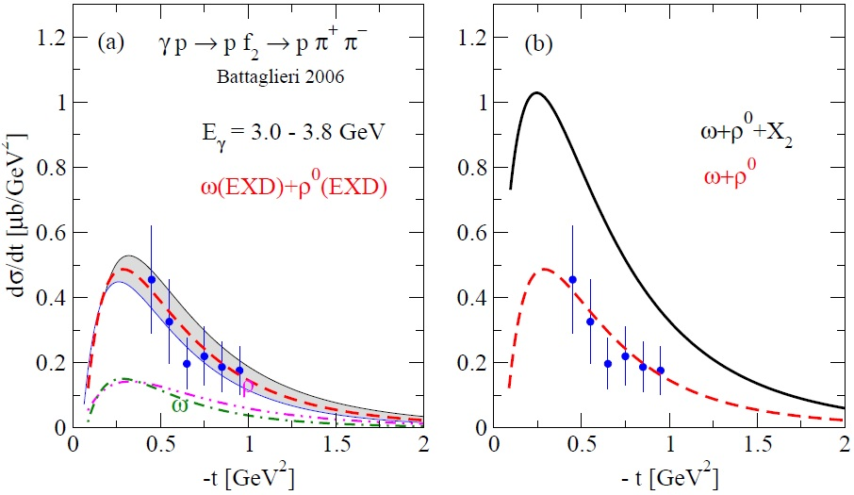
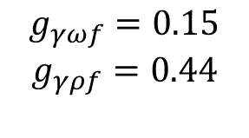


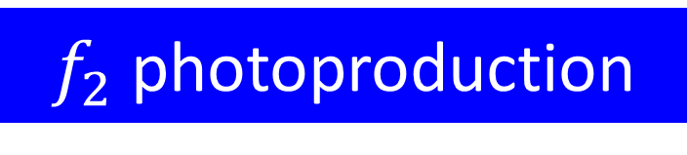
$f_{2}$ photoproduction
Carver, PRL 126, 082002 2021
$$g_{γωf}=0.15$$
$$g_{γρf}=0.44$$
$b_{2}^{0}(Q)$
CLAS 2021 g12 data inconsistent with 2009 g11 data
Battaglieri, PRD 80, 072005 2009
$b_{2}^{0}$

Slide 12
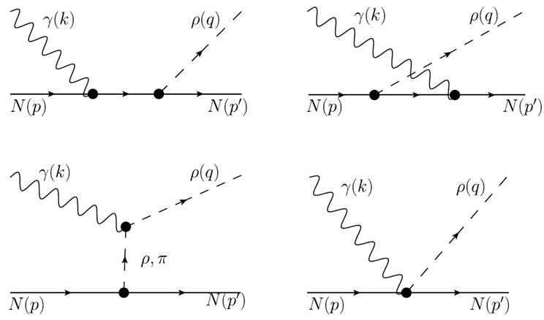



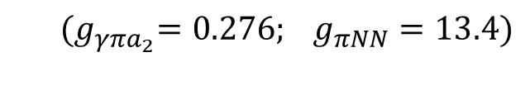
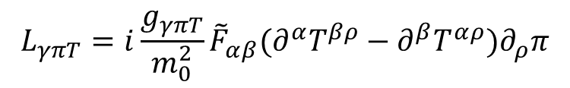


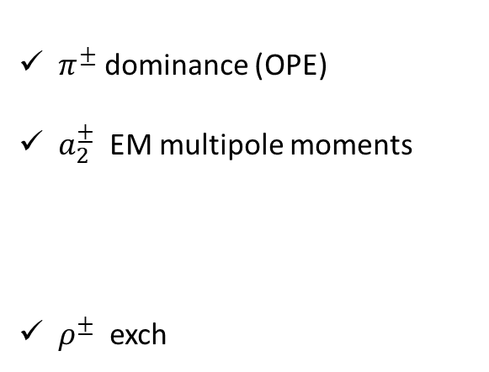
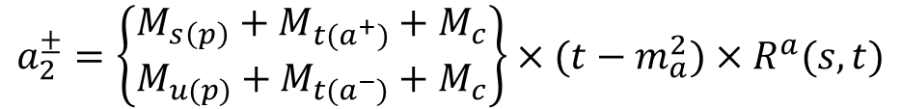
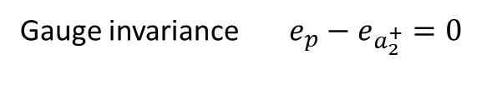

Charged tensor meson $a_{2}^{±}$ photoproduction
Production mechanism :
$$M\left(a_{2}^{±}\right)=π^{±}+a_{2}^{±}+ρ^{±}$$
Gauge invariance $e_{p}−e_{a_{2}^{+}}=0$
$$a_{2}(q)$$
$$a_{2}(q)$$
$π^{±}$ dominance (OPE)
$a_{2}^{±}$ EM multipole moments
$ρ^{±}$ exch
$$a_{2}(q)$$
$$a_{2}(q)$$
$$γa_{2}^{±}a_{2}^{±} \text{EM} \text{vertex}$$
$(g_{a_{2}NN}^{\left(1\right)}=1.4; { κ}_{a_{2}}=2.28)$
$$π+a_{2}+ρ(Q)$$
$$a_{2}^{±}=\left\{\begin{matrix}M_{s\left(p\right)}+M_{t(a^{+})}+M_{c} \\ M_{u(p)}+M_{t(a^{−})}+M_{c}\end{matrix}\right\}×(t−m_{a}^{2})×R^{a}(s,t)$$
$$L_{γπT}=i\frac{g_{γπT}}{m_{0}^{2}}{\tilde{F}}_{αβ}(∂^{α}T^{βρ}−∂^{β}T^{αρ})∂_{ρ}π$$
${(g}_{γπa_{2}}=0.276; g_{πNN}=13.4)$

Slide 13

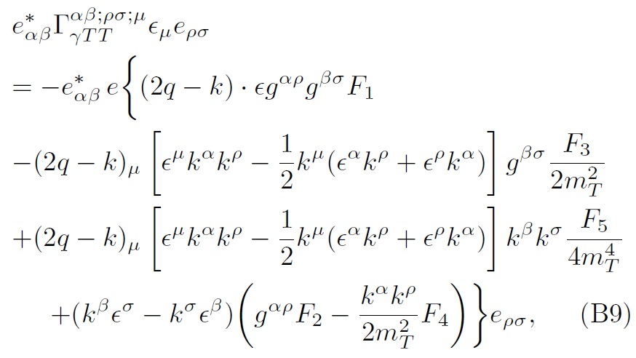





EM vertex form factors of tensor meson
Ward identity for charge cpling
Ecker, EPJC 52, 315 2007
Gauge invariant EM vertex
Aliev, JPG 37, 075008 2010
$$F_{1}\left(0\right)=G_{E_{0}}(0)=1$$
$$F_{2}\left(0\right)=G_{M_{1}}(0)=2+κ_{a}$$
$F_{3}=−2G_{E_{0}}+G_{E_{2}}$ ${+G}_{M_{1}}$
$F_{4}=−G_{M_{1}}$ ${+G}_{M_{3}}$
$F_{5}=F_{4}+G_{E_{0}}−G_{E_{2}}$ ${+G}_{E_{4}}$

Slide 14
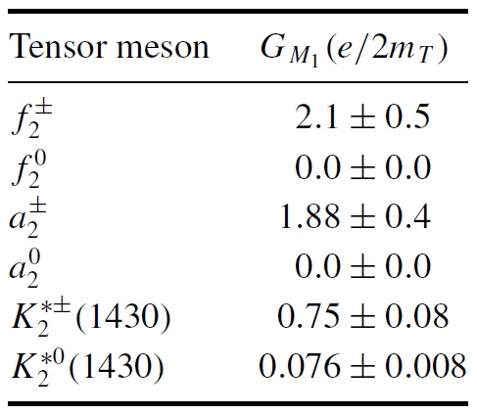
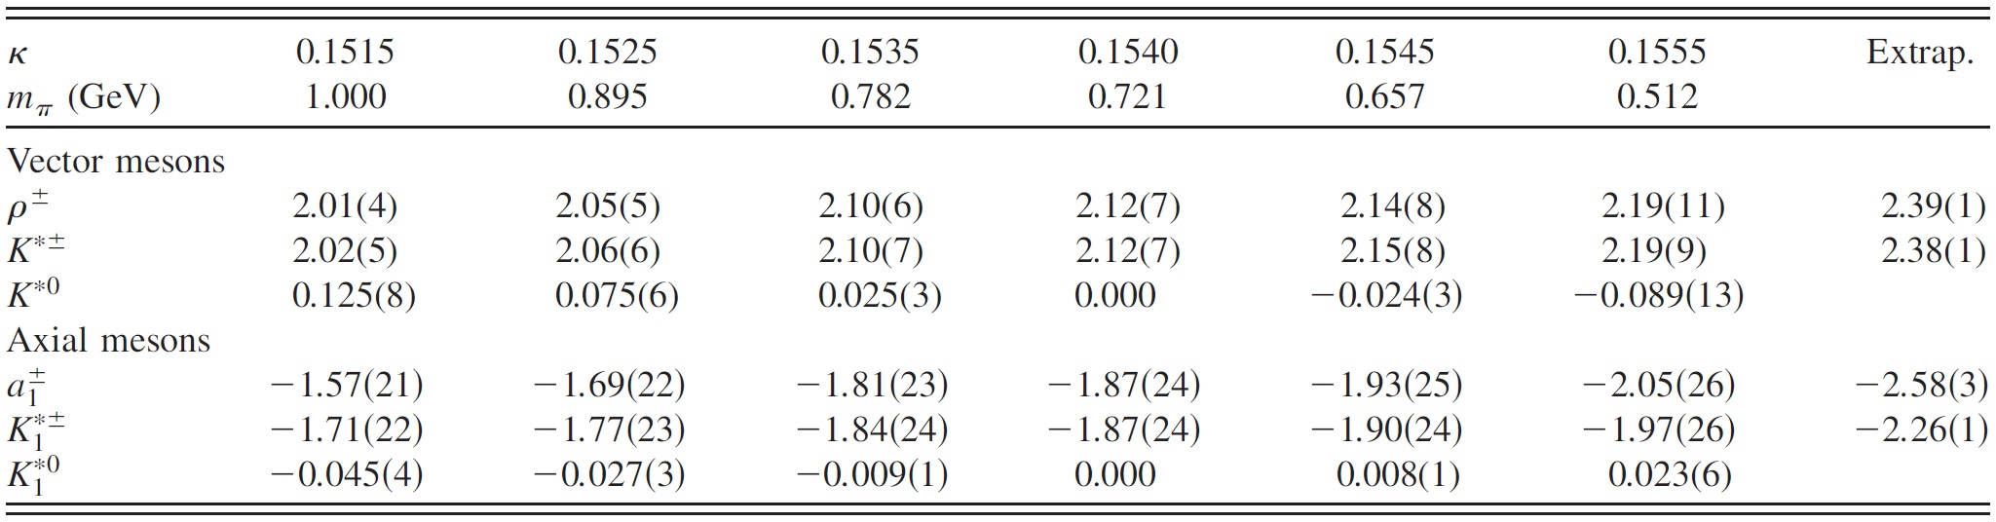
Magnetic moment of high-spin mesons
Tensor meson magnetic moments
Aliev, JPG 37, 075008 2010
vector and axial meson magnetic moments from LQCD
* For spin-1 meson EMFFs; BG Yu, PLB 765, 221 2017
Lee, PRD 78, 094502 2008

Slide 15
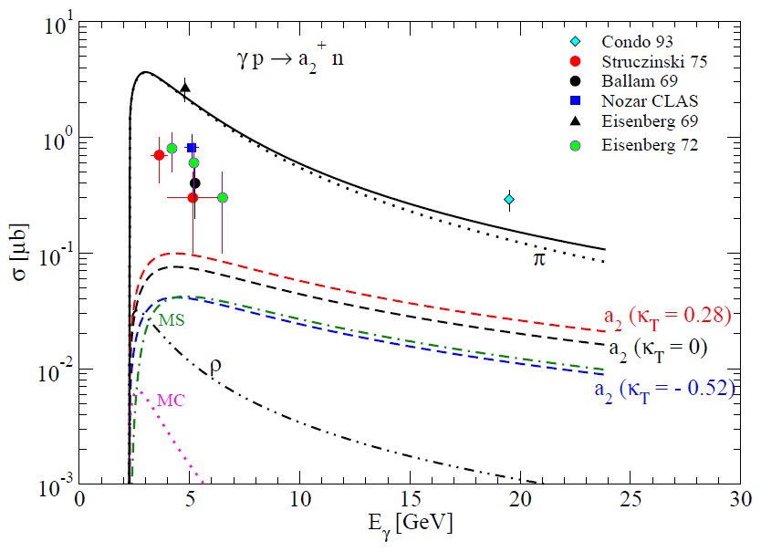
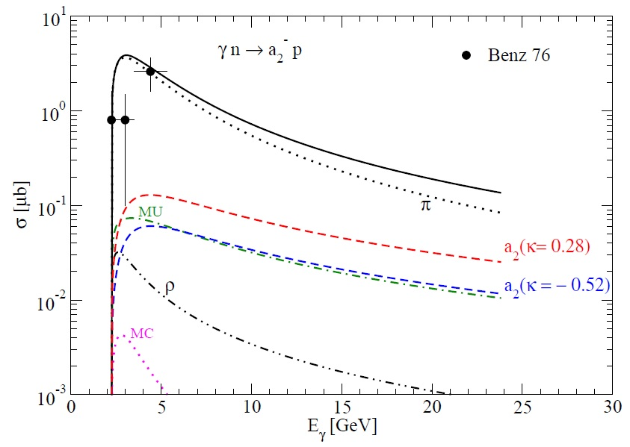
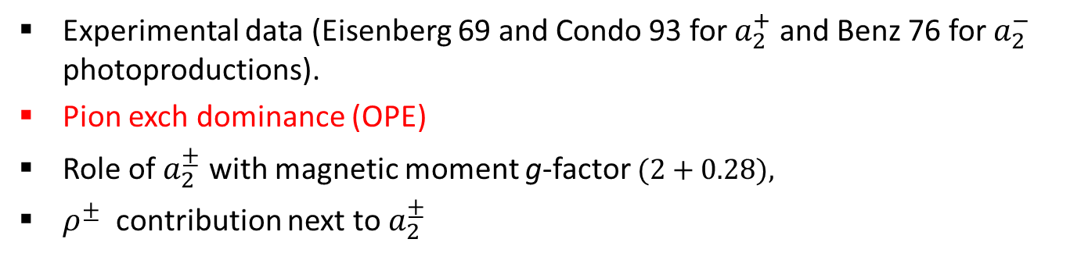

$γN→Na_{2}^{±}$ photoproduction
Experimental data (Eisenberg 69 and Condo 93 for $a_{2}^{+}$ and Benz 76 for $a_{2}^{−}$ photoproductions).
Pion exch dominance (OPE)
Role of $a_{2}^{±}$ with magnetic moment g-factor $(2+0.28),$
$ρ^{±}$ contribution next to $a_{2}^{±}$

Slide 16
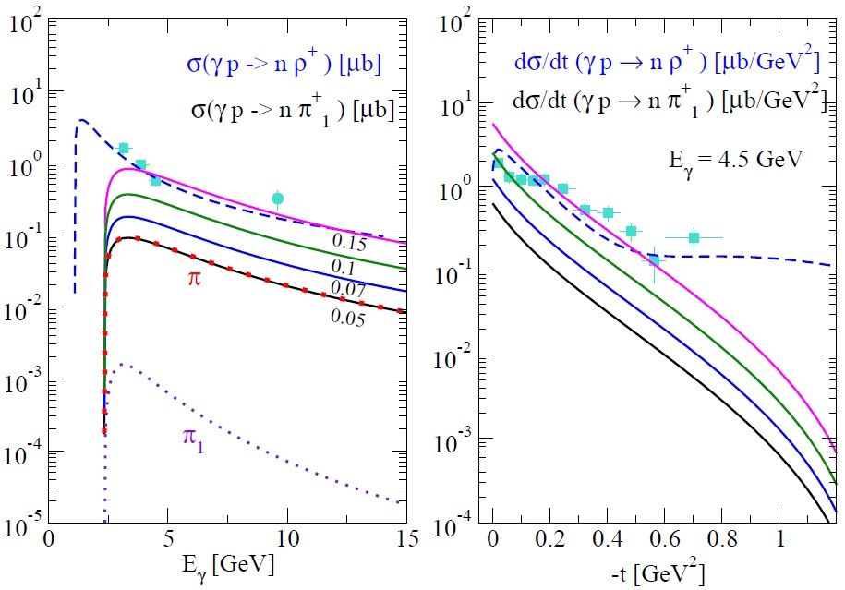


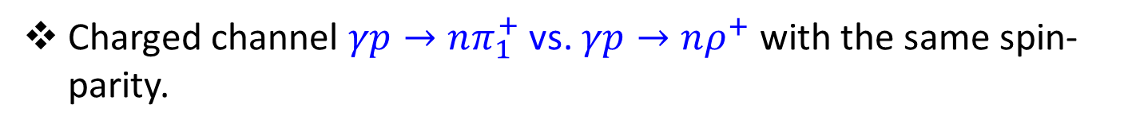


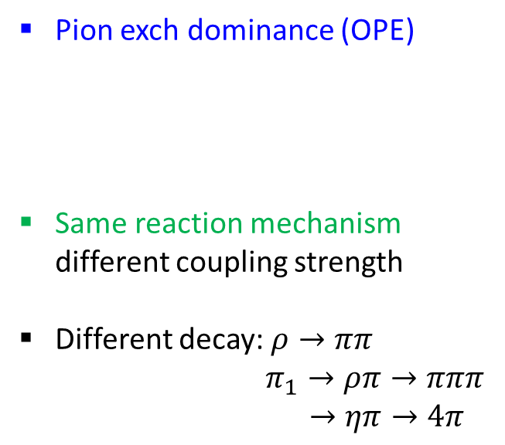
$π_{1}\left(1400\right) (1^{−+})$ photoproduction
Charged channel $γp→nπ_{1}^{+}$ vs. $γp→nρ^{+}$ with the same spin-parity.
$$M=\sqrt{2}\left[π(140)+π_{1}\right]$$
$M_{π}=−\frac{g_{γππ_{1}}}{m_{0}}ε^{μναβ}ε_{μ}k_{ν}ζ_{α}^{∗}q_{β}\overline{u}$ i$g_{πNN}γ_{5} ue^{−iπα_{π}(t)}R^{π}(s,t)$
Barber, ZPC 2, 1 (1979)
BG Yu, PLB 765, 221 2017
Pion exch dominance (OPE)
Same reaction mechanism different coupling strength
Different decay: $ρ→ππ$
$π_{1}→ρπ→πππ$
$→ηπ→4π$
$$α_{π }=0.7\left(t−m^{2}\right)$$
$$α_{ρ, π_{1}}=0.9\left(t−m^{2}\right)+1$$

Slide 17
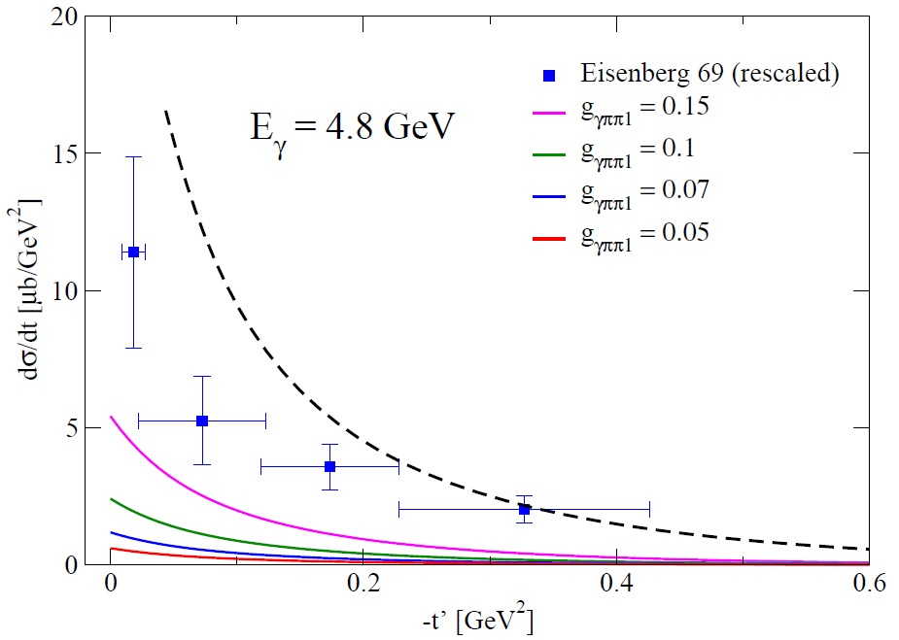




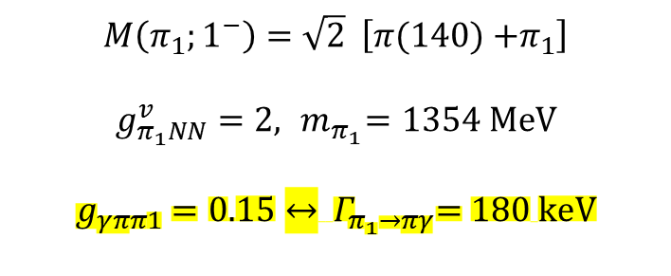

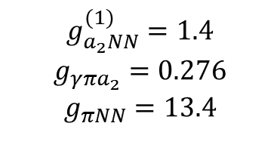


$γp→nπ_{1}^{+}$ vs. $γp→na_{2}^{+}$
$$γp→na_{2}^{+}→nρπ^{+}$$
Szczepaniak. PLB 516, 72 2001
$$π_{1}$$
Eisenberg, PRL 23, 1322 1969
$$a_{2}2^{++}$$
$$E_{γ}=8 GeV$$
OPE
$$π+π_{1}$$
$$γp→nπ_{1}^{+}→nρπ^{+}$$
$$g_{a_{2}NN}^{(1)}=1.4$$
$$g_{γπa_{2}}=0.276$$
$$g_{πNN}=13.4$$
$$M\left(π_{1};1^{−}\right)=\sqrt{2} \left[π(140){+π}_{1}\right]$$
$$g_{π_{1}NN}^{v}=2, { m}_{π_{1}}=1354 MeV$$
$$g_{γππ1}=0.15↔ { Γ}_{π_{1}→πγ}=180 keV$$

Slide 18


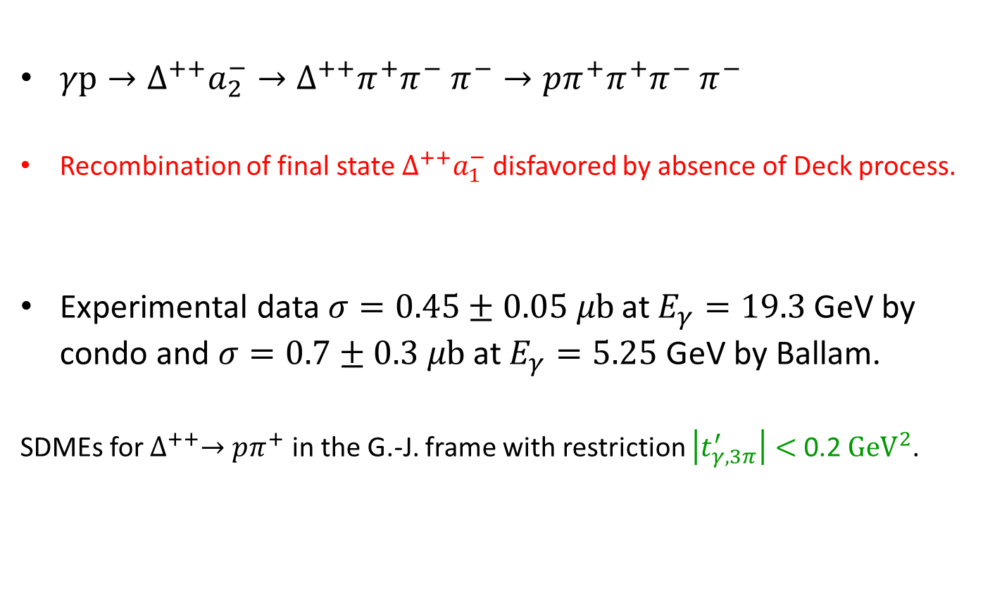
$γp→∆^{++}a_{2}^{−}$ photoproduction
Condo, PRD 41, 3317 1990
Ballam, PLB 30, 421 1969
4 pion photoproduction
$γp→∆^{++}a_{2}^{−}→∆^{++}π^{+}π^{−} π^{−}→pπ^{+}π^{+}π^{−}$ $π^{−}$
Recombination of final state $∆^{++}a_{1}^{−}$ disfavored by absence of Deck process.
Experimental data $σ=0.45±0.05 μb$ at $E_{γ}=19.3$ GeV by condo and $σ=0.7±0.3 μb$ at $E_{γ}=5.25$ GeV by Ballam.
SDMEs for $∆^{++}→pπ^{+}$ in the G.-J. frame with restriction $\left|t_{γ,3π}^{′}\right|<$ 0.2 ${GeV}^{2}$.
Cross section
(requirement of peripheral $∆^{++}$ formation)

Slide 19
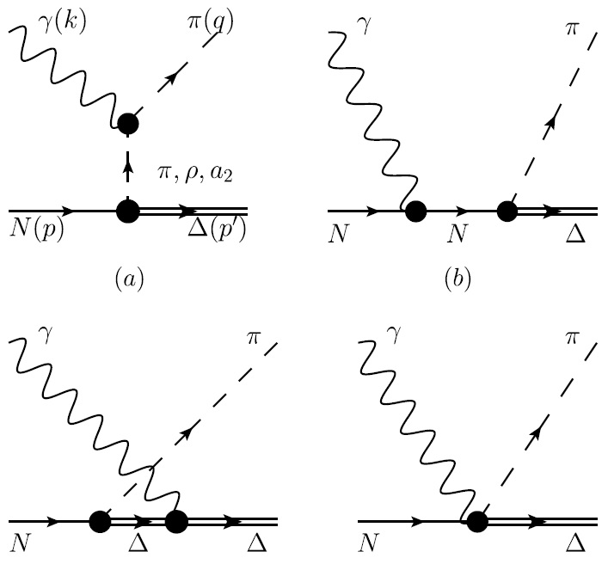
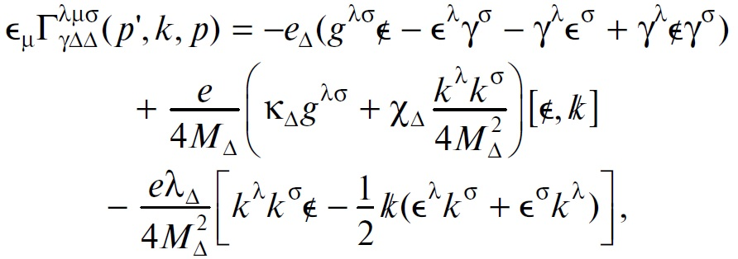




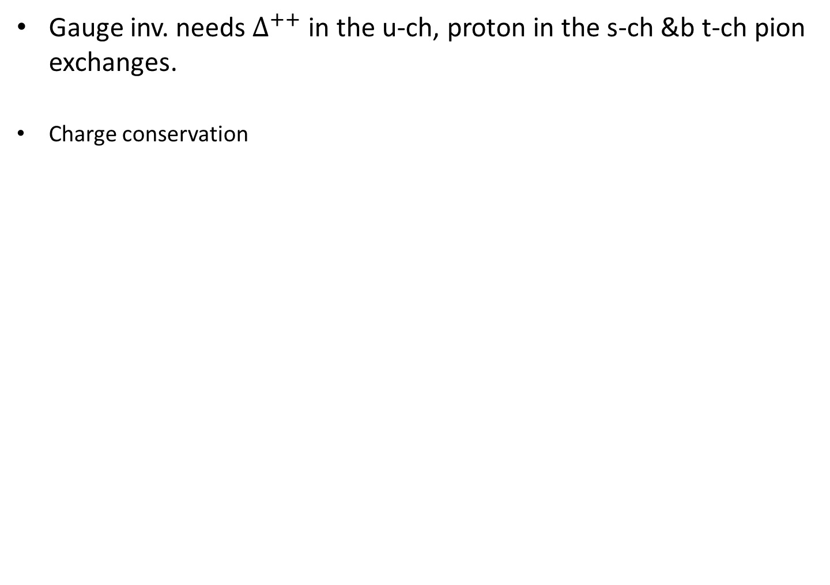

$γp→∆^{++}a_{2}^{−}$ photoproduction
Gauge inv. needs $∆^{++}$ in the u-ch, proton in the s-ch &b t-ch pion exchanges.
Charge conservation
$a_{2}^{−}$
$a_{2}^{−}$
$$e_{p}−e_{∆^{++}}−e_{a_{2}^{−}}=0$$
Highly divergent spin-3/2 & spin-2
propagators
$a_{2}^{−}$
$a_{2}^{−}$
BG Yu, PPNL 15, 438 2018
Ward identity
EM vertex $∆^{++}$

Slide 20
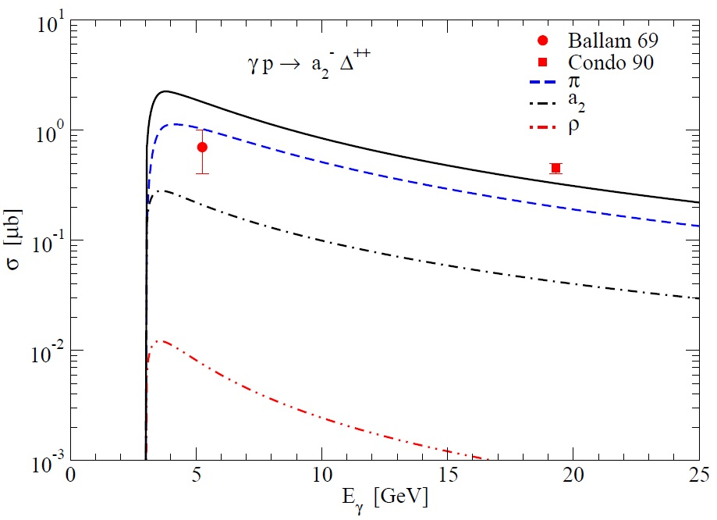



$γp→∆^{++}a_{2}^{−}$ photoproduction
Charge coupling $γ∆∆$ for minimal gauge model
$→$ convergence at high energies
EM structure of $a_{2}^{±}$ with $e_{a_{2}}+κ_{a_{2}}$
Pion-exch dominance
Diff. crs. sec. at 5.25 GeV with dip by pion degenerate phase

Slide 21



Multi-pion photoproduction
$γp→nπ^{+}π^{−}$ $π^{+}$ and $γp→pπ^{+}π^{−}$ $π^{+}π^{−}$
$γp→na_{2}^{+}$
$γp→na_{1}^{+}$
$γp→∆^{++}a_{2}^{−}$
$γp→nπ_{1}^{+}$
Ballam et. al. PLB 30, 421 (1969)
$a_{2},a_{1}$, $π_{1}→ρπ→πππ$
$→ηπ→ππππ$
Pion-exch dominance in all channels.
Three channels are comparable.
Sensitivity of $π_{1}$ to $g_{γππ_{1}}$

Slide 22

Summary & conclusions
Study of exotic mesons is important to understand quark confinement.
Since exotic mesons decay to multi-pions, it is of interest to investigate the possibility of exotic meson in photoproduction of tensor meson disentangled from the multi-pion in the final state.
In neutral tensor meson cases possibility of exotic tensor $b_{2}^{0}$ ${(2}^{+ −})$ is discussed to describe JLab experiments.
In charged tensor $a_{2}^{±}$ production, pion exchange dominance in most charged
meson photoproductions and $π_{1}$ photoproduction is studied and compared with
$a_{2}^{±}N$ and $a_{2}^{−}∆^{++}$ channels.
Our models for tensor meson photoproduction will help identify the possibility of exotic mesons in future multi-pion photoproductions.

Slide 23
Thank you for listening

Slide 24


Reggeized meson exchange model
neutral case
Based on $\left\{q\overline{q}\right\}$ structure of tensor meson rather than molecular structure of $f_{2} \sim ρρ$.
Reggeized model for vector meson exchange but exclude axial meson exchange by the decay $A→Tγ$ (and vice versa) unlikely.
Role of exotics tensor $b_{2}\left(1800\right) 2^{+ −}$ with magnetic transition
Meyer & Haarlem, PRC 82, 025208 2010
$$M=ω+ρ^{0}+b_{2}\left(1800\right)$$
Reggeized model
$α_{J}\left(t\right)=0.9\left(t−m_{J}^{2}\right)+J$ for $φ=V, T,{ b}_{0}, π_{1}, { b}_{2}$
$α_{J}\left(t\right)=0.7\left(t−m_{J}^{2}\right)+J$ for $φ=π, A, B, H$
$$R^{φ}\left(s,t\right)=\frac{πα^{′}×phase}{Γ\left[α_{φ}\left(t\right)+1−J\right]\sin\left[πα_{φ}\left(t\right)\right]}{\left(\frac{s}{s_{0}}\right)}^{α_{φ}\left(t\right)−J}$$

Slide 25








Decay angular distribution I
Decay angular distribution $f_{2}→ππ$
SDMEs, spin polarizations important to identify meson resonance decaying to $2^{+} → 0^{−}+0^{−}$
$f_{2}$

Slide 26





Beam polarization asymmetry
Beam polarization asymmetry
Tensor meson polarization tensor $e_{λ}^{μν}\left(q\right)$ for plane wave and helicity state between two different beam polarizations.
No dip structure in $Σ$, unlike $π^{0}$ photoproduction.

Slide 27


SDMEs
Beam polarization indistinguishable?
SDMEs $ρ_{λλ′}^{α} (α=0,1,2,3; λ,λ^{′}=1,…,5)$ four $5×5$ matrices
9 independent $ρ_{λλ}^{α}$ in each $α$ for $γp→pf_{2}→pππ$

Slide 28
Multi-pion photoproduction
$γp→nπ^{+}π^{−}$ $π^{+}$ and $γp→pπ^{+}π^{−}$ $π^{+}π^{−}$
$γp→na_{2}^{+}$
$γp→na_{1}^{+}$
$γp→∆^{++}a_{2}^{−}$
$γp→nπ_{1}^{+}$
Ballam et. al. PLB 30, 421 (1969)
$a_{2},a_{1}$, $π_{1}→ρπ→πππ$
$→ηπ→ππππ$
Pion-exch dominance in all channels.
Three channels are comparable.
Sensitivity of $π_{1}$ to $g_{γππ_{1}}$

Slide 29






$\text{D}\text{ecay} \text{angular} \text{distribution} \text{I}$I
BG Yu, PRC 96, 025208 2017
Decay angular distribution for peripheral $∆^{++} →pπ^{+}$ in the G.-J. frame
The expression of ${\frac{3}{2}}^{+}→$ ${\frac{1}{2}}^{+}+0^{−}$ is written as
Beam polarization asymmetry

Slide 30




JPAC for neutral tensor photoproduction
No evidence for $ρ$ background in g12 measurement and inconsistency with data by Carver.
Inconsistency of TMD with minimal cpl. $β_{i}$ in Regge model between $a_{2}^{0}(1320)$ and $f_{2}(1270)$ channels.
No information reported on radiative decay of axial meson to tensor meson and vice versa.
$$E_{γ}=4 \sim 5 GeV$$
wrong?
$$E_{γ}=3.4 GeV$$
correct?

Slide 31


Axial meson photoproduction
$a_{1}$ photoproduction Condo et. al. PLB 30, 421 (1969)
Large width $Γ_{a_{1}}=400\sim 600$ MeV $→$ Difficult to isolate single particle state
Pion exch dominance $Γ_{a_{1}→πγ}=311 keV$
$a_{1}(1^{+})→ρ(1^{−})π(0^{−})→πππ$ with $\frac{D}{S}\left(ρπ\right)=−0.062±0.02$
Ishida et. al. PRD 40, 1497 (1989)
$π_{1}(1^{−})→ρ(1^{−})π(0^{−})→πππ$ with $p(ρπ)$
No structure of the formal reaction vs. p-wave ang. distrib. of the latter process
$b_{1}$ photoproduction Blackett et. al. arXiv:hep-ex/9708032
$Γ_{b_{1}}=142±9$ MeV $→$ Easy to identify
Pion, $η$ exch dominance $Γ_{b_{1}→πγ}=144 keV,{ Γ}_{b_{1}→ηγ}=354 keV$
$b_{1}(1^{+})→ω(1^{−})π(0^{−})→ππππ$ with $\frac{D}{S}\left(ωπ\right)=0.277±0.027$
Ishida et. al. PRD 40, 1497 (1989)
Brau et. al. PRD 37, 2379 (1988)
Atkins et. al. NPB 243, 1 (1984)
$γp→pωπ^{0}→pπ^{+}π^{−}$ $π^{0}$ $π^{0}$

Slide 32






$γp→pb_{1}^{0}$ photoproduction
$γp→pb_{1}^{0}→pωπ^{0}→pπ^{+}$ $π^{−}$ $π^{0}$ $π^{0}$
$g_{γπb_{1}}=0.189,{ g}_{πNN}=13.4$
CQM $→$ $g_{γηb_{1}}≈3g_{γπb_{1}},{ g}_{ηNN}=3$
$γp→pπ_{1}^{0}$ from $π_{1}^{0}→b_{1}π$
$g_{γππ_{1}}=0.1 , { g}_{πNN}=−13.4$
$b_{1}^{0}(q)$
$π+η+π_{1}+Ρomeron$
Ballam et. al. NPB 76, 375 (1974)
Motivated by $π_{1}^{0}→b_{1}π$ decay
Confirm $b_{1}^{0}→ωπ^{0}$ decay
Test of $π_{1}$ exch in the t-ch.
Allow $C$ - even exchange.
Pion-exch insufficient to agree with data.
More contribution to high energy region; role of $η$ exchange?, possibility of Pomeron exchange?

Slide 33







$γp→∆^{+}b_{1}^{0}$ photoproduction
$b_{1}^{0}(q)$
$γp→∆^{+}b_{1}^{0}→pπ^{0}ωπ^{0}→$ $pπ^{0}π^{+}π^{−}π^{0}π^{0}$
$$g_{γπb_{1}}=0.189,{ g}_{πN∆}=2∗\sqrt{\frac{2}{3}}$$
$π+π_{1}+Ρomeron$
Foda, Thesis (2021)
$∆^{+} (p’)$
Pion-exch not enough to agree with data.
$η$ exchange negligible with $ηNΔ≈0$ by $Δ→πN=$ 99.4%
Large discrepancy of model prediction with data due to experimental uncertainty in 5$π$ in the final state?
?

