Slide 1


Republic of Kazakhstan
B meson decays
Aidos Issadykov
in collaboration with Mikhail A. Ivanov, N. Soni,
S. Dubnicka, A. Liptaj and S. Sakhiyev
14th APCTP-BLTP JINR Joint Workshop - Memorial Workshop in Honor of Prof. Yongseok Oh : Modern problems in nuclear and elementary particle physics

Slide 2
Outline:
Introduction – Motivation
b-s transitions
b-d(u) transitions
b-c transitions
Conclusion

Slide 3
Why B Physics?
The Higgs sector (2013)
Cosmology (2006, 2011, 2017, 2019, 2020)
The New Physics :
  confinement, exotic hadrons,
etc.

Slide 4
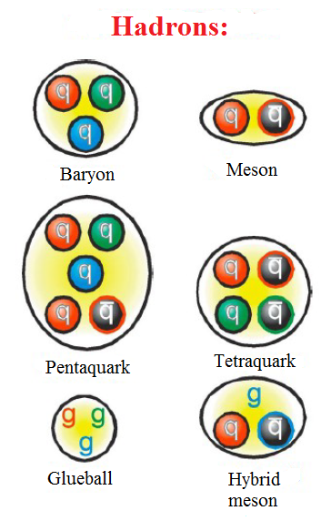
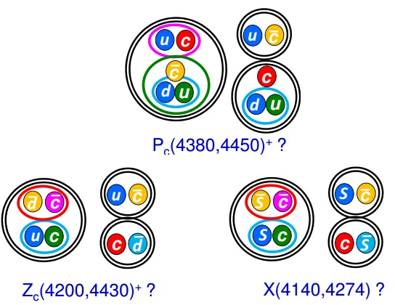
Exotic hadrons

Slide 5
DOES SM DESCRIBE ALL EXPERIMENTAL DATA?
The pool of the EW data

Slide 6
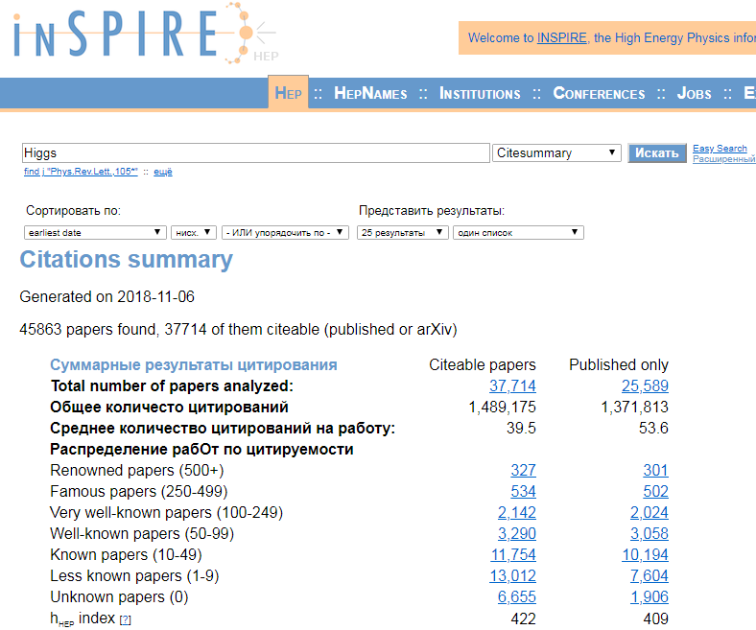

Slide 7
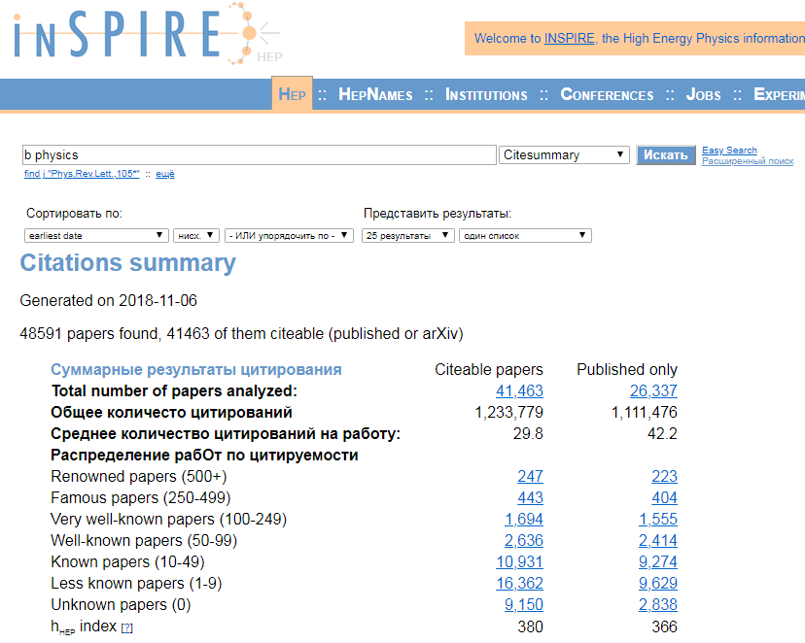

Slide 8
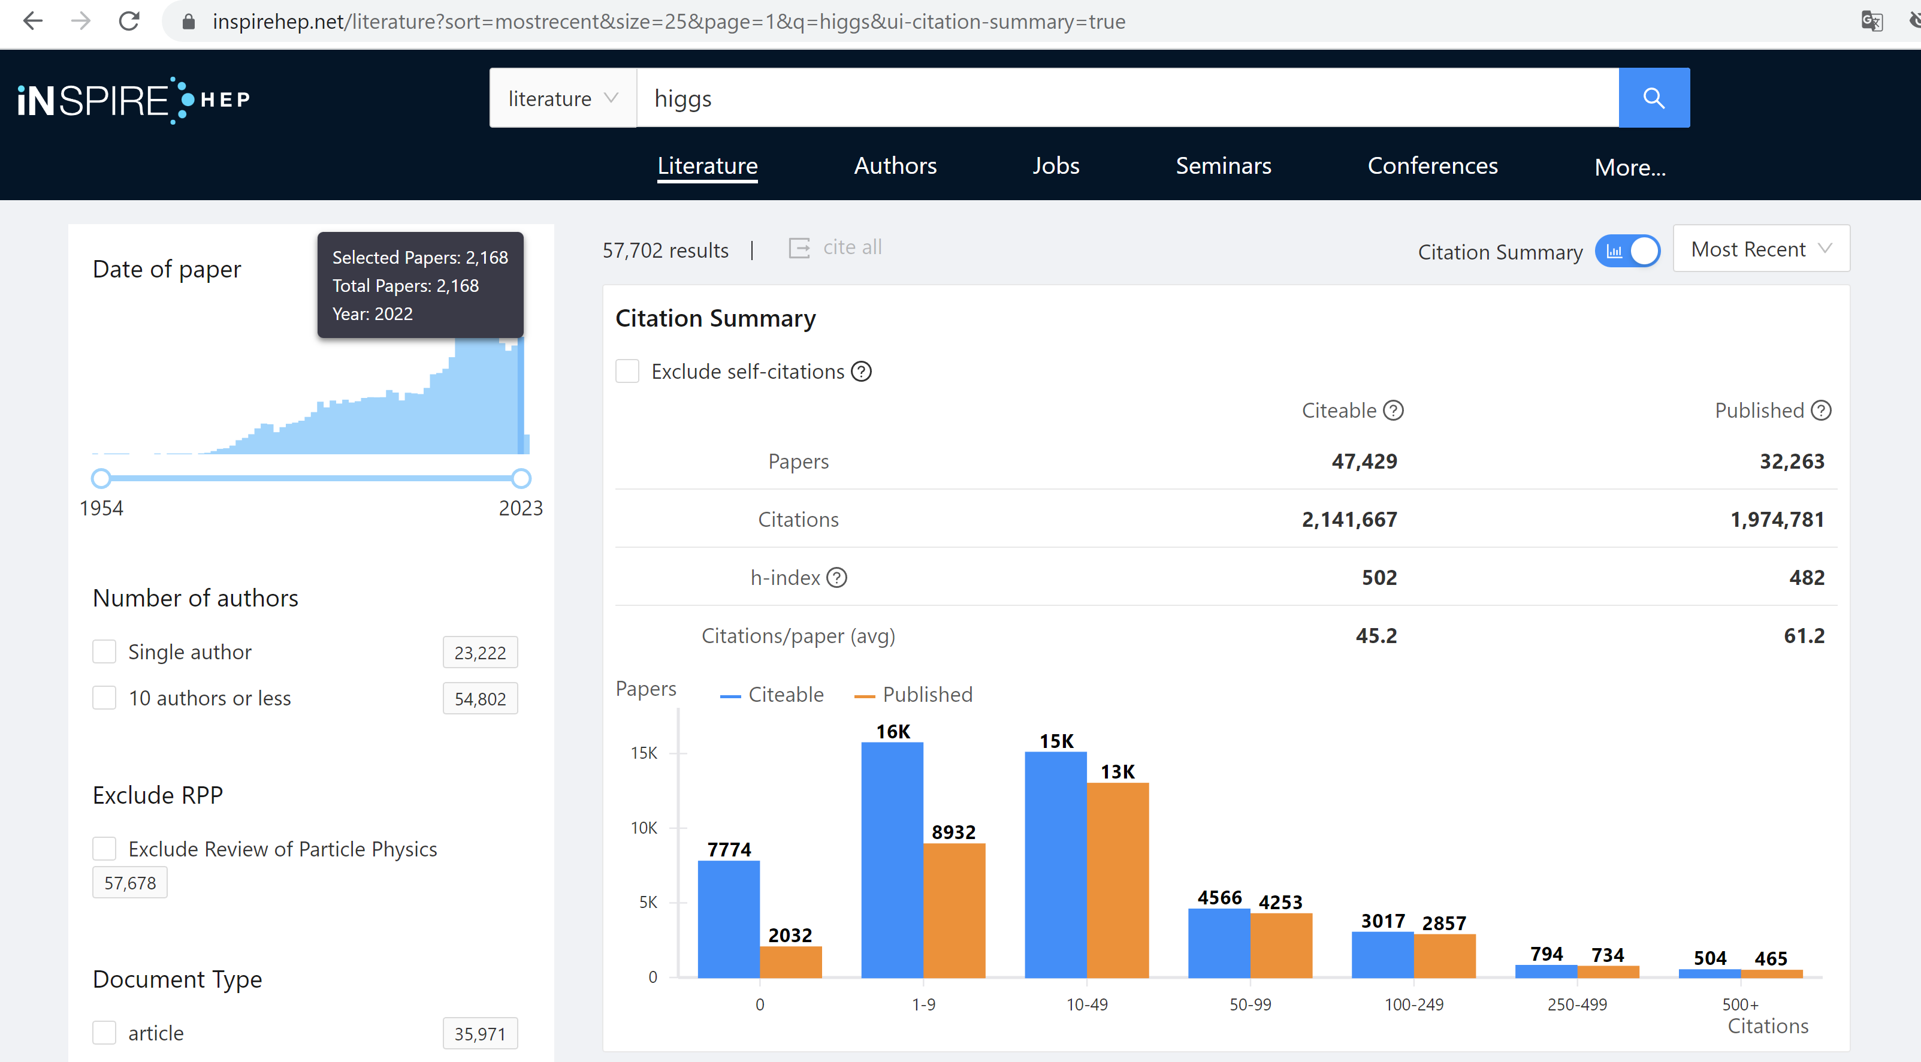

Slide 9
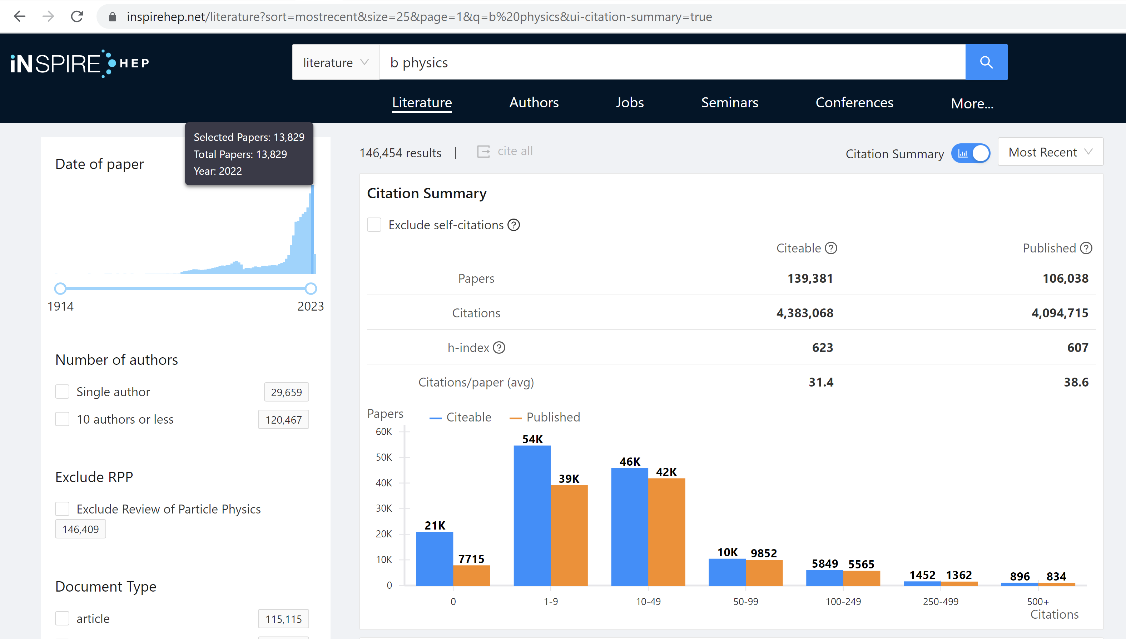

Slide 10
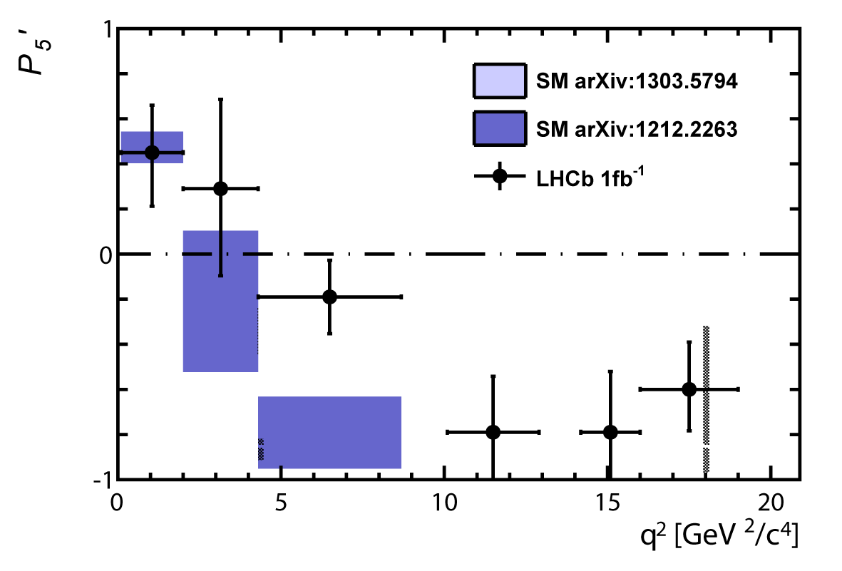
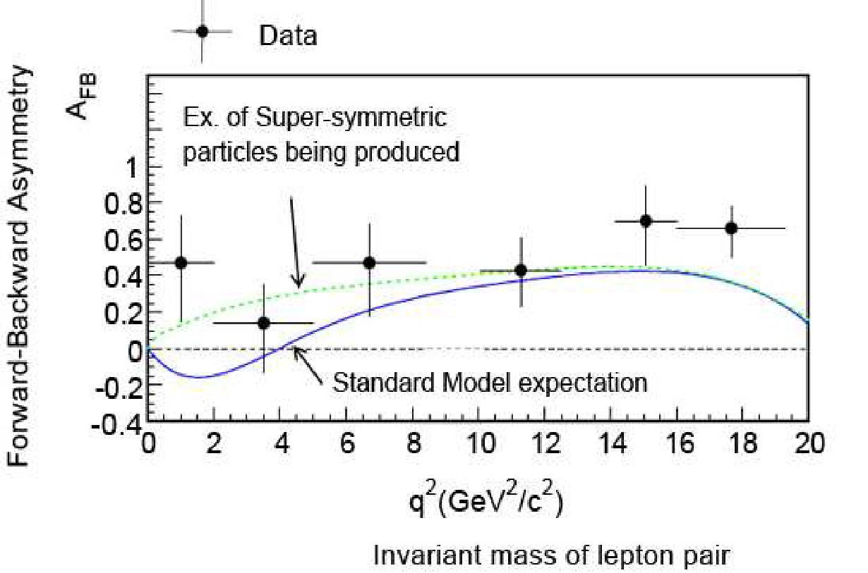
THE LHCB COLLABORATION REPORT IN 2013
3.7 σ
~ 3 σ
*Phys.Rev.Lett. 111 (2013) 191801

Slide 11
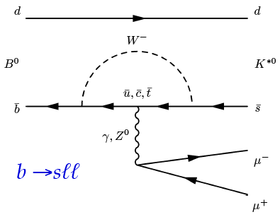
$\text{b} \text{→} \text{s} \text{transition}$
Loop-level decays b → sℓ⁺ℓ⁻:
forbidden at tree-level in SM
sensitive to NP contributions in loops

Slide 12
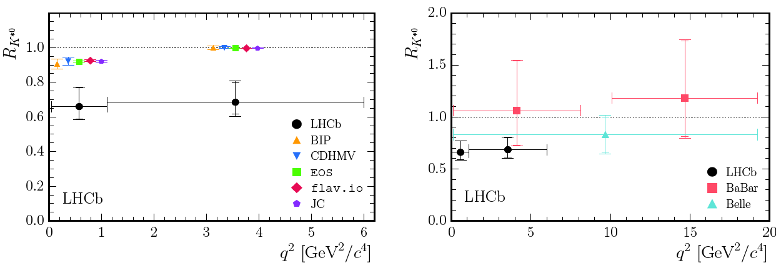
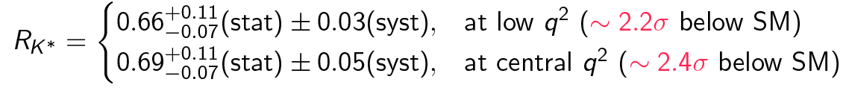
$$R_{K^{∗}}$$

Slide 13
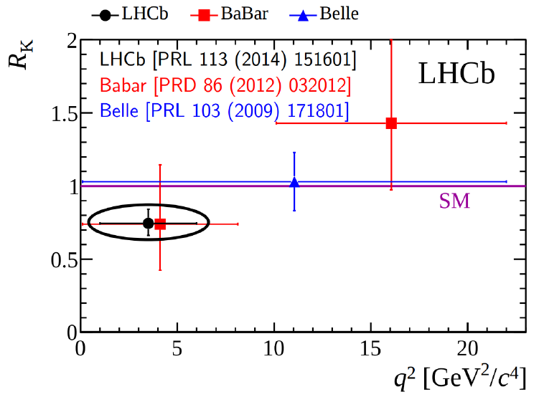
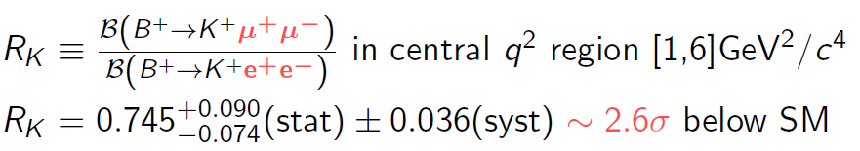
$$R_{K^{}}$$

Slide 14
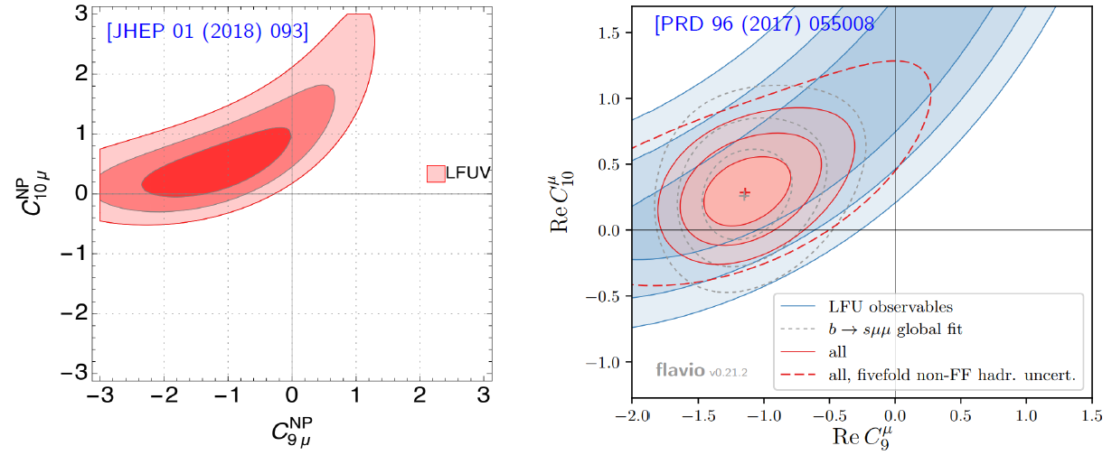
$R_{K^{∗}}$ and $R_{K^{}}$
Combination of R_{K*} , R_{K} and [PRL 118 (2017) 111801] is ~4σ from SM

Slide 15
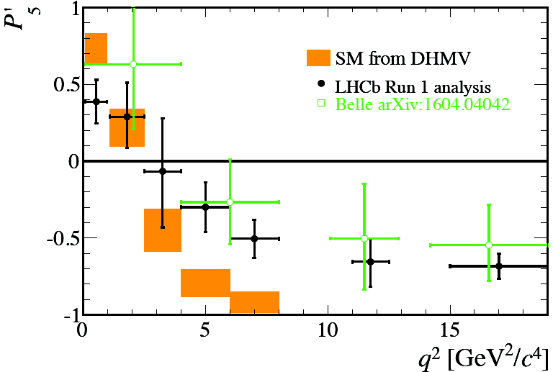
Angular observables
LHCb measurement differs by 3.4σ from the SM prediction
Can be explained by
- SM charm-loop effects (cannot explain tension in R_{K*})
- New Physics??

Slide 16
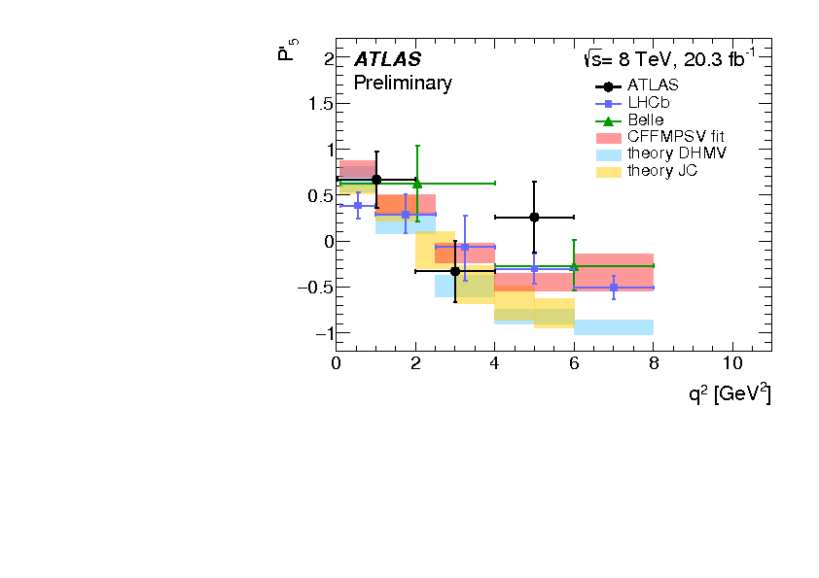
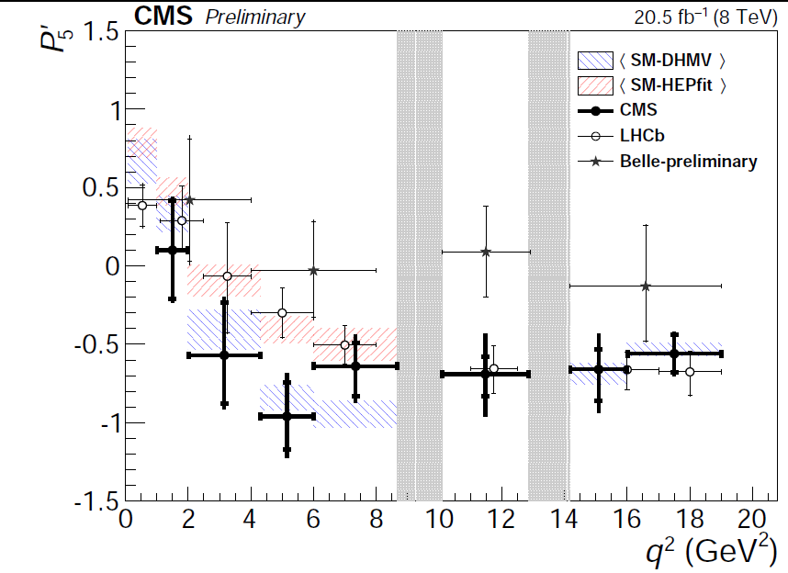
Angular observables
ATLAS measurement differs by 2.7σ from the SM prediction.
CMS results are consistent with SM prediction and other measurements

Slide 17
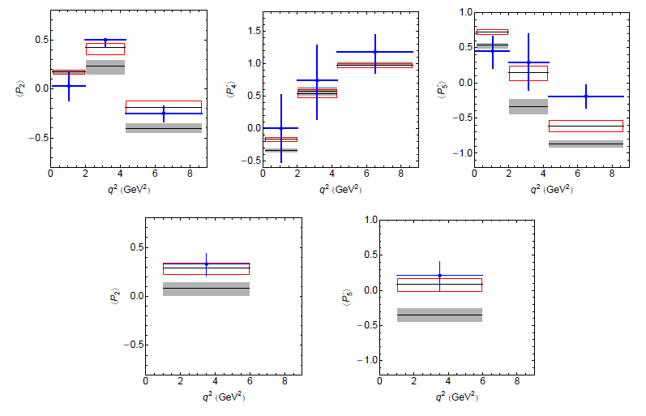
$New physics in \text{b} \text{→} \text{s} \text{transition}$
*

Slide 18
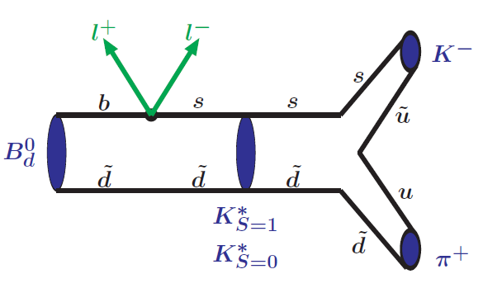
SCHEMATIC VIEW OF $\text{В→}\text{K}\text{π}\text{ + ℓ}\text{+}\text{ℓ}\text{−}$ DECAY
* Issadykov, Ivanov, Sakhiyev, Phys.Rev. D91 (2015) no.7, 074007

Slide 19

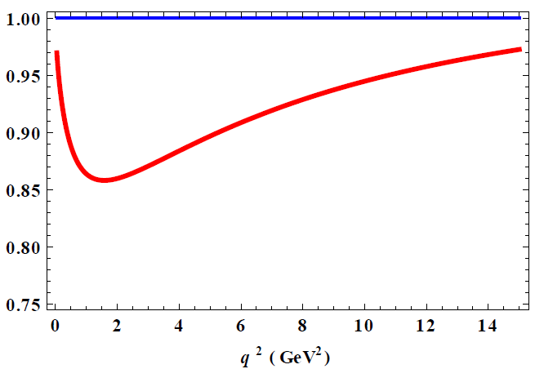
IMPACT OF S WAVE CONTRIBUTION
14 %
~ 6 %
* Issadykov, Ivanov, Sakhiyev, Phys.Rev. D91 (2015) no.7, 074007

Slide 20
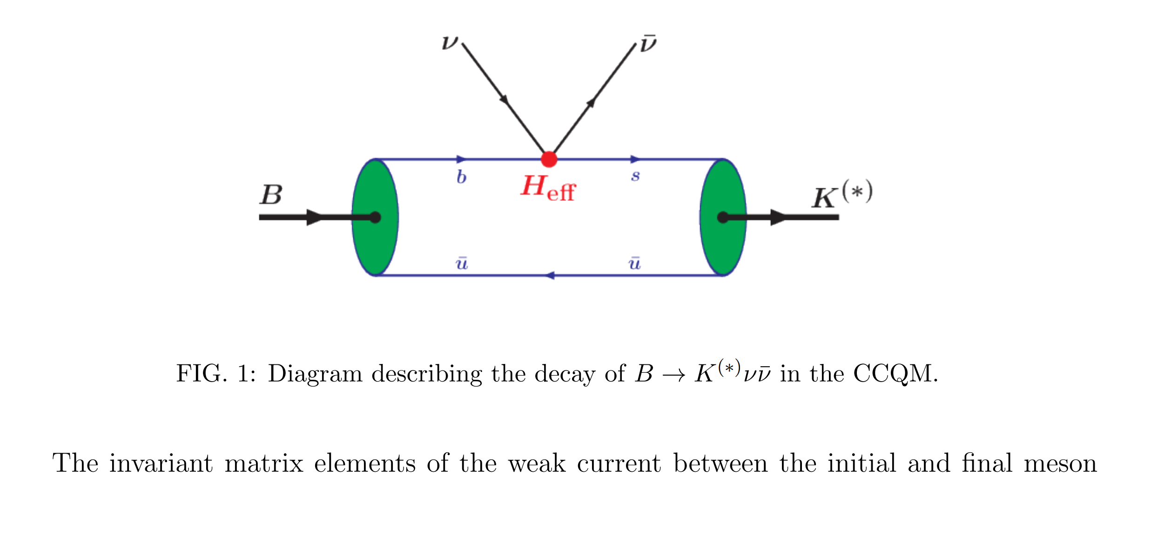


$$\text{b}\text{ → }\text{s} υ υ$$
* Issadykov, Ivanov , Modern Physics Letters A, 2023, 2350006

Slide 21
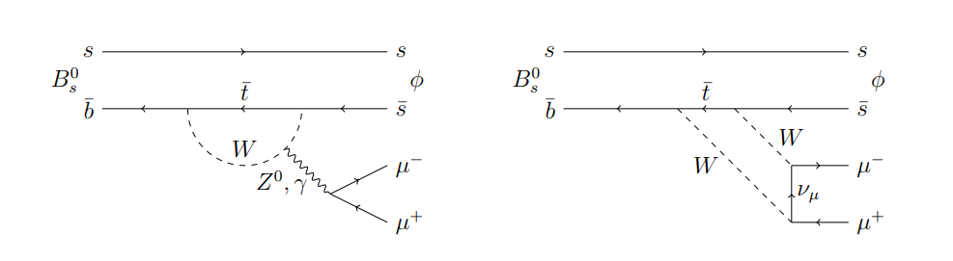

Slide 22
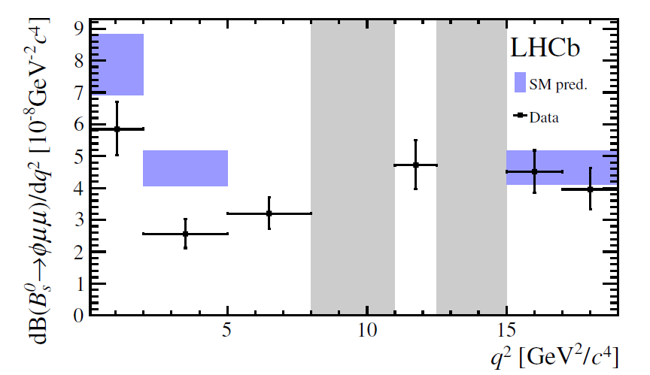
~ 3.1 σ
*

Slide 23
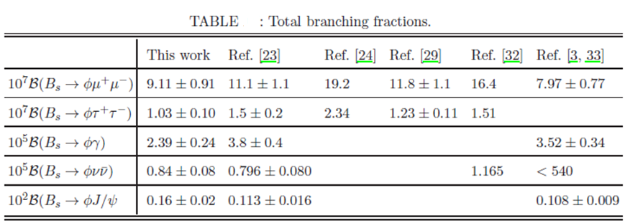
THE VALUES OF BRANCHING FRACTIONS
Our
Exp
* Dubnicka, Dubnickova, Issadykov, Ivanov, Liptaj, Phys.Rev. D93 (2016) no.9, 094022

Slide 24
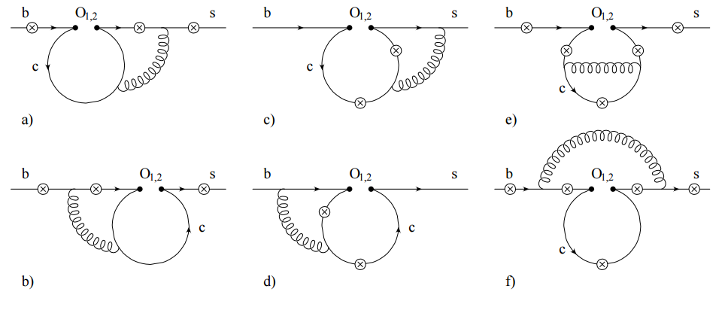
CC-RESONANCE CONTRIBUTIONS

Slide 25
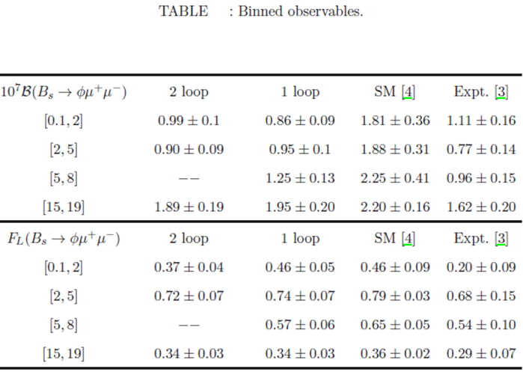
ANGULAR OBSERVABLES AND DIFFERENTIAL BRANCHING
* Dubnicka, Dubnickova, Issadykov, Ivanov, Liptaj, Phys.Rev. D93 (2016) no.9, 094022

Slide 26
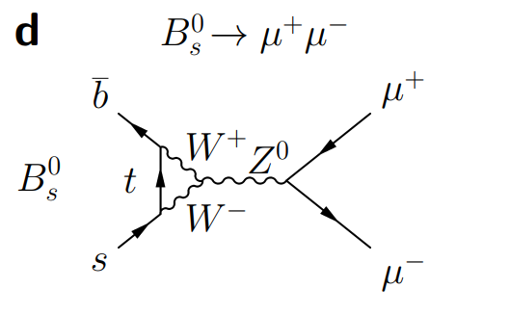
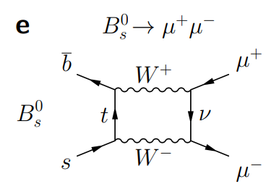
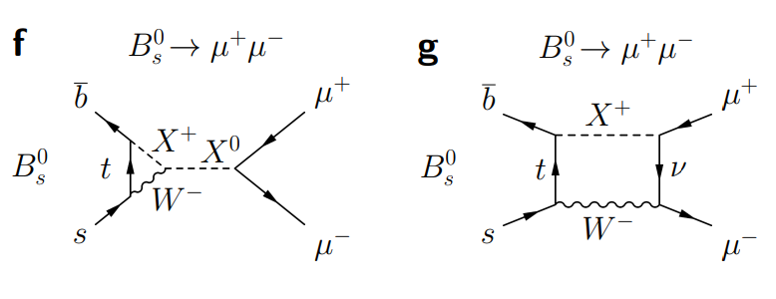
$$B_{s}→μμ$$

Slide 27
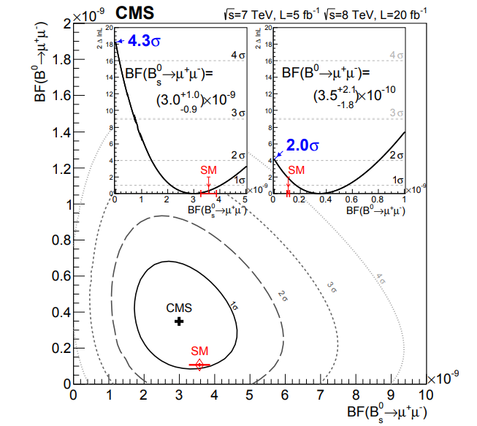
$$B_{s}→μμ$$
* Phys. Rev. Lett. 111, 101804 (2013)

Slide 28
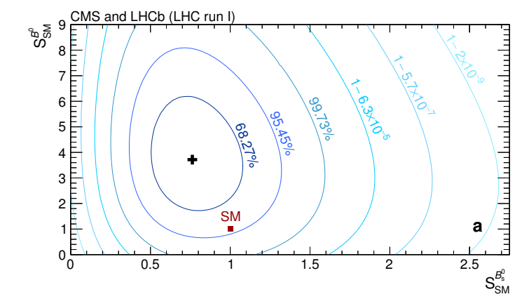
$$CMS \& LHCb combined analysis$$
* Nature 522 (2015) 68-72

Slide 29
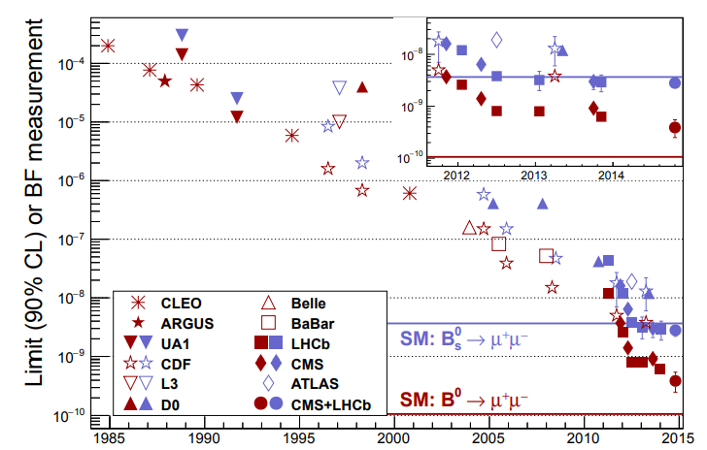
$$CMS \& LHCb combined analysis$$
* Nature 522 (2015) 68-72

Slide 30
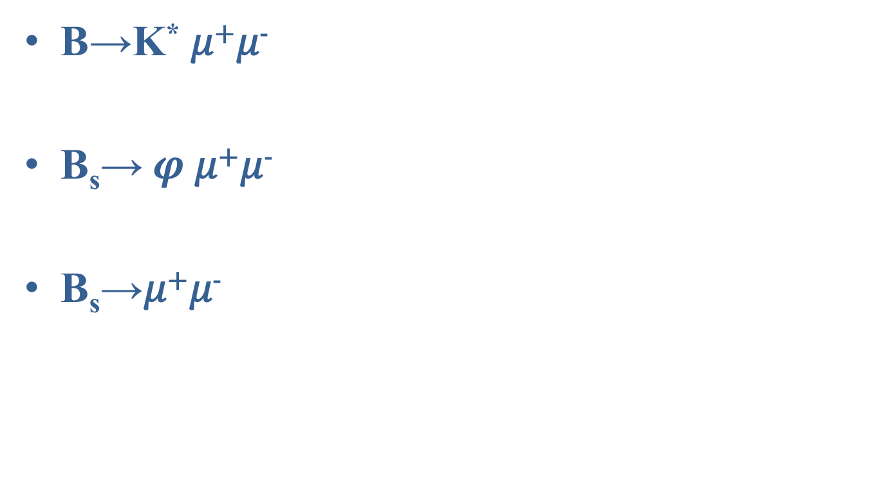
b-s anomaly
В→K* 𝜇⁺𝜇⁻
В_{s}→ $φ$𝜇⁺𝜇⁻
В_{s}→𝜇⁺𝜇⁻
up to 3.7 σ
up to 3.1 σ
up to 5 σ !
2015*

Slide 31
b-s anomaly
В→K* 𝜇⁺𝜇⁻
В_{s}→ $φ$𝜇⁺𝜇⁻
В_{s}→𝜇⁺𝜇⁻
up to 3.7 σ
up to 3.1 σ
less than 2 σ
Now*

Slide 32
b-s anomaly
В→K* 𝜇⁺𝜇⁻
В_{s}→ $φ$𝜇⁺𝜇⁻
В_{s}→𝜇⁺𝜇⁻
up to 3.7 σ
about 2.2 σ
less than 2 σ
Now*

Slide 33
b-s anomaly
В→K* 𝜇⁺𝜇⁻
В_{s}→ $φ$𝜇⁺𝜇⁻
В_{s}→𝜇⁺𝜇⁻
up to 3.7 σ ??
about 2.2 σ
less than 2 σ
Now*

Slide 34
b-s anomaly
Issadykov, Ivanov, Sakhiyev, Phys.Rev. D91 (2015) no.7, 074007 (arXiv:1502.05280)
Dubnicka, Dubnickova, Issadykov, Ivanov, Liptaj, Phys.Rev. D93 (2016) no.9, 094022 (arXiv:1602.07864)
Issadykov, Ivanov, Phys.Part.Nucl.Lett. 15 (2018) no.4, 393-396 (arXiv:1807.04996)
Issadykov, Ivanov, Mod. Phys. Lett. A (2023), 2350006 (arXiv:2211.10683)

Slide 35
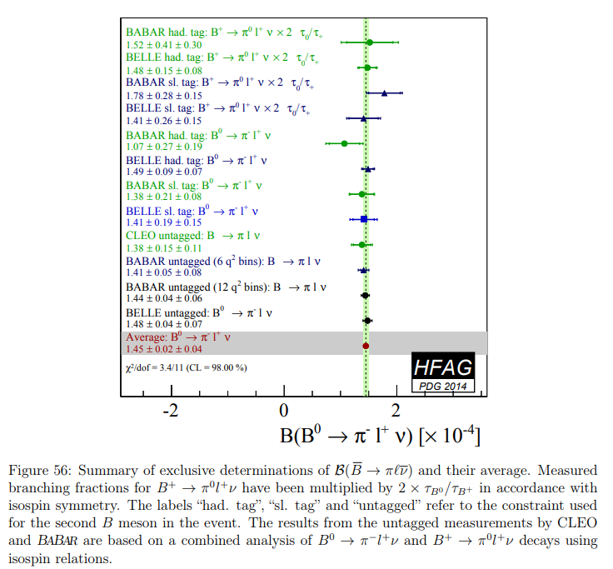
b-d transitions

Slide 36
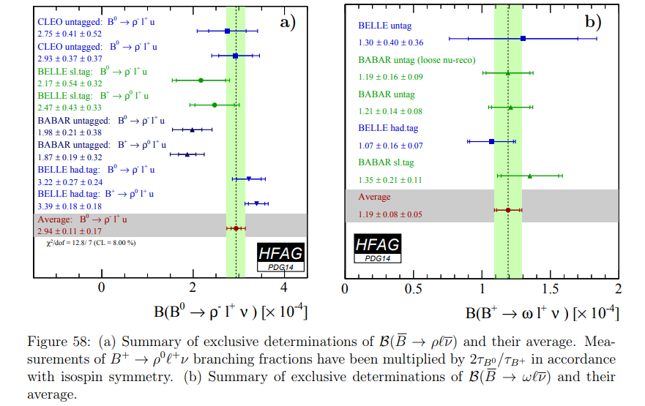
b-d transitions
* 1412.7515

Slide 37
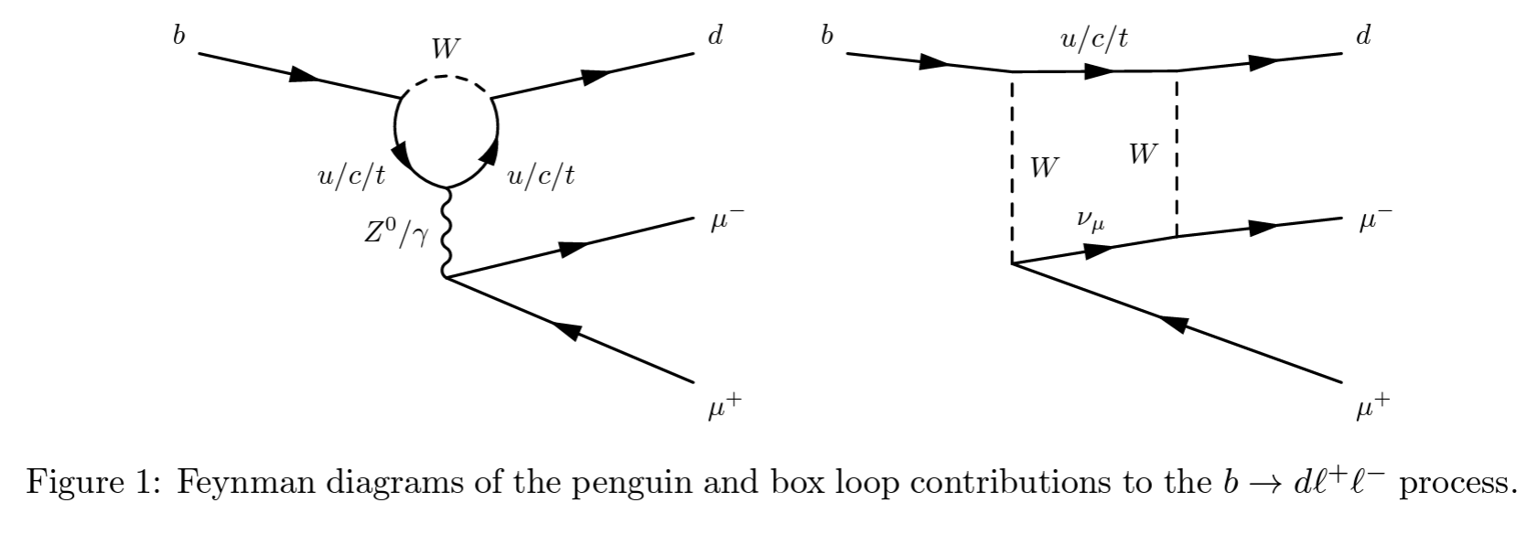

b-d transitions
*R. Aaij et al. (LHCb Collaboration), JHEP 07, 020 (2018), arXiv:1804.07167 [hep-ex].

Slide 38
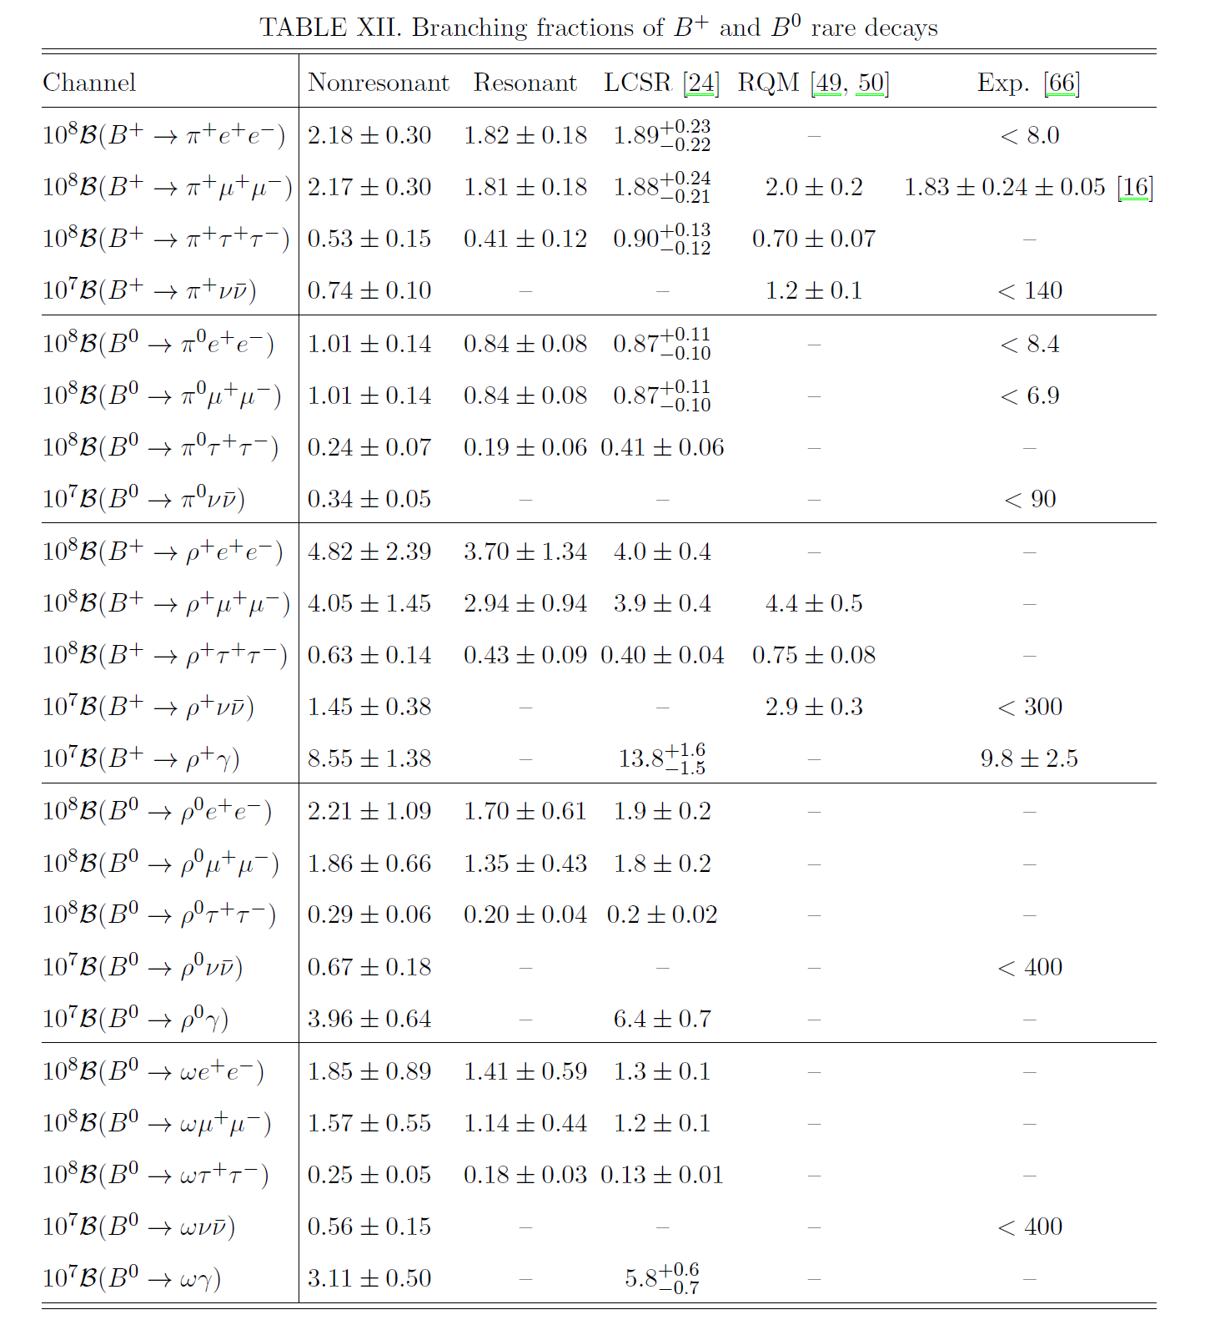

Slide 39
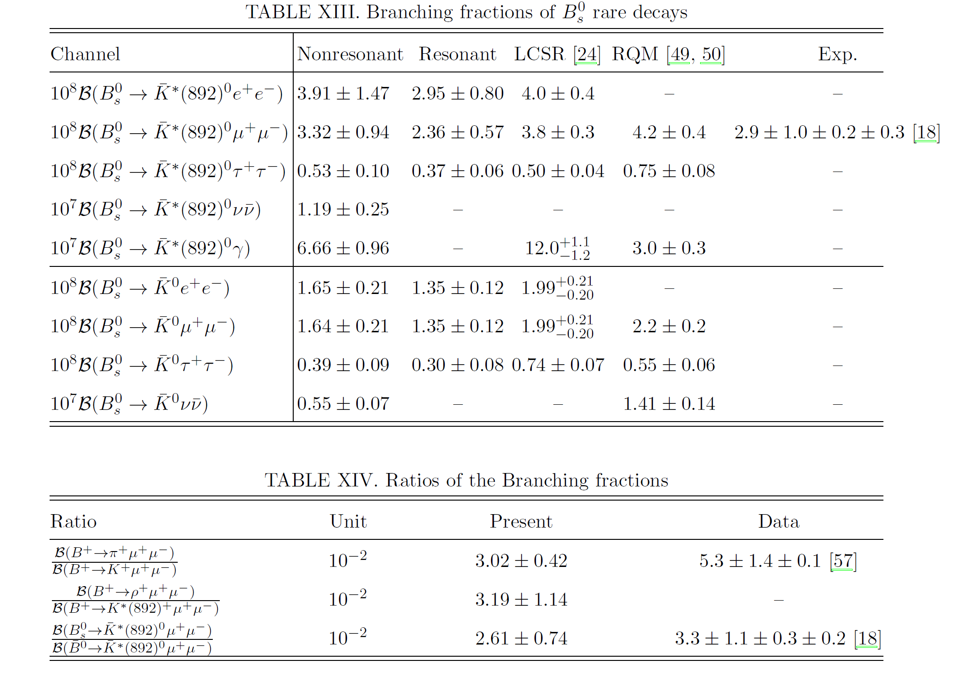
*Soni, Issadykov, Gadaria, Patel, Pandya, EPJ A 2022, 58(3), 39

Slide 40
b-d transitions
Soni, Issadykov, Gadaria, Patel, Pandya, AIP Conf.Proc. 2377 (2021) 1, 090006
Soni, Issadykov, Gadaria, Patel, Pandya, EPJ A 2022, 58(3), 39
Issadykov, Phys.Part.Nucl.Lett. 19 (2022) 5, 460-462

Slide 41
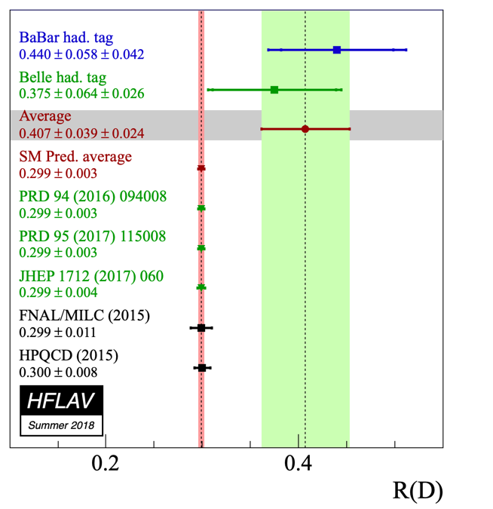
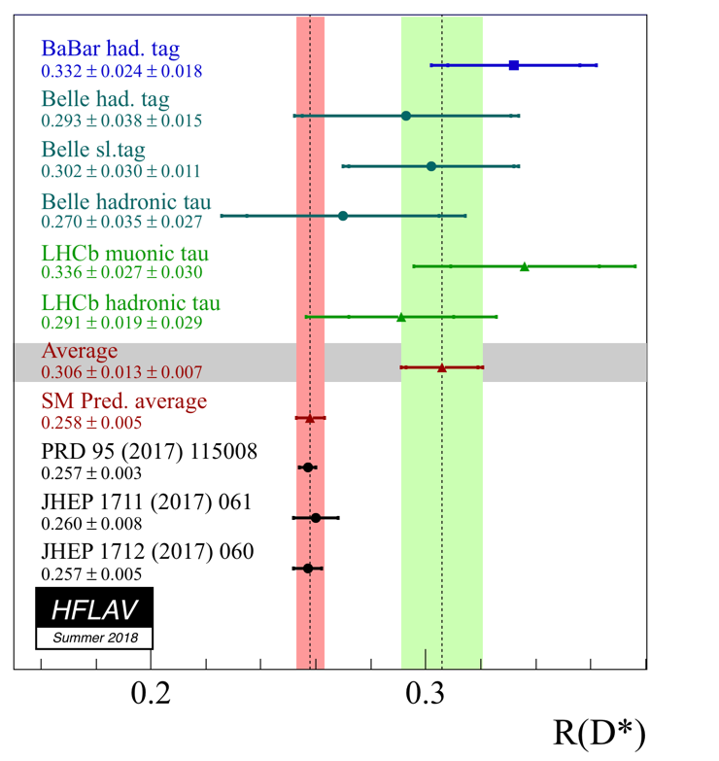
b-c transition
2.3 σ discreapancy
3.0 σ discreapancy
* https://hflav-eos.web.cern.ch/hflav-eos/semi/summer18/RDRDs.html

Slide 42
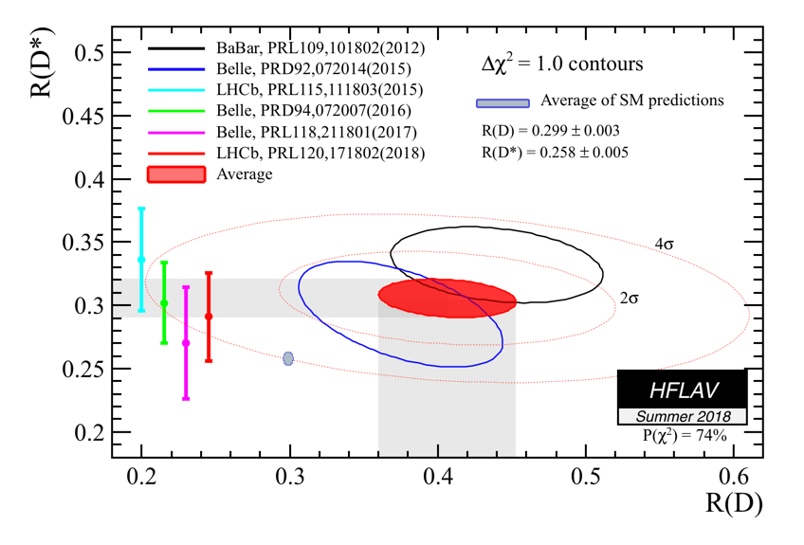
b-c transition
(One of ) the largest discrepancies between SM and measurement
Up to 4.1 σ disagreement

Slide 43
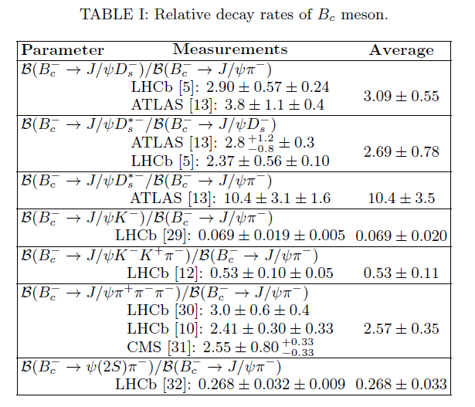
Experimental data

Slide 44
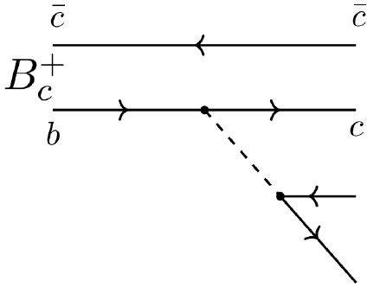


Semileptonic decays of B_{c} meson
*R. Aaij et al. Phys.Rev.Lett. 120 (2018) no.12, 121801
arXiv:1711.05623

Slide 45
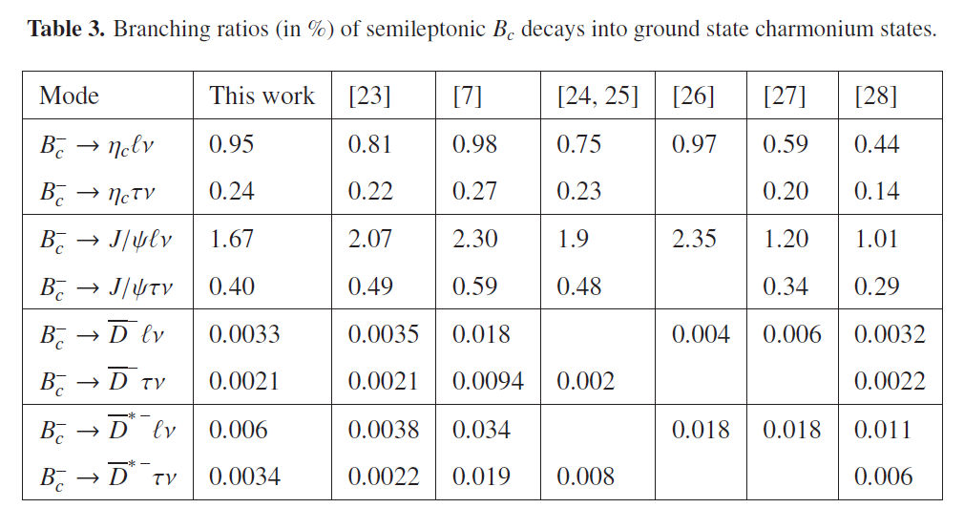
Branching ratios of semileptonic $B_{c}$ decays
*Issadykov, Ivanov, Nurbakova, EPJ Web Conf. 158 (2017) 03002

Slide 46
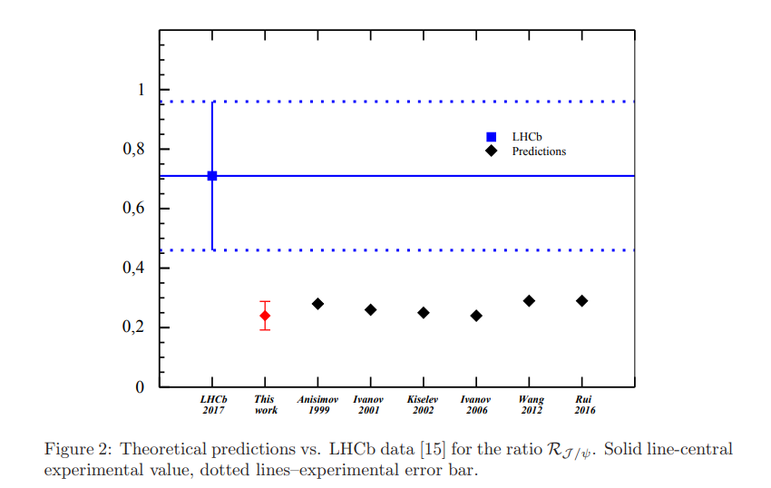
Branching ratios of semileptonic $B_{c}$ decays
*Issadykov, Ivanov, Phys.Lett. B783 (2018) 178-182

Slide 47
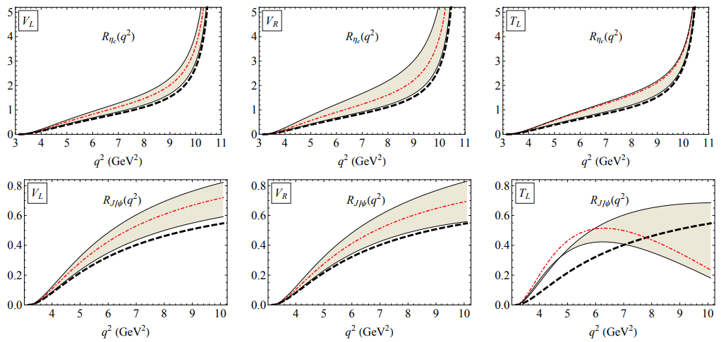
New Physics effects in semileptonic $B_{c}$ decays
*Tran, Ivanov, Körner, Santorelli, Phys.Rev. D97 (2018) no.5, 054014
arXiv:1801.06927

Slide 48



Nonleptonic decays of B_{c} meson
LHCb collaboration(nonleptonic):
*R. Aaij et al. [LHCb Collaboration], JHEP 1309 (2013) 075
*R. Aaij et al. [LHCb Collaboration], JHEP 1609 (2016) 153

Slide 49
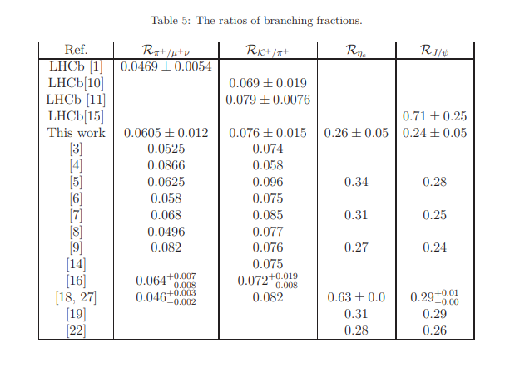
Nonleptonic decays of B_{c} meson

Slide 50
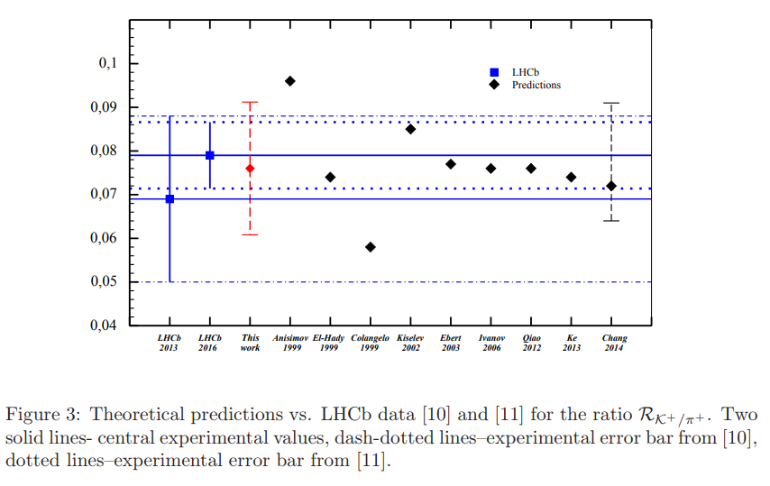
Ratios of branching fractions
*Issadykov, Ivanov, Phys.Lett. B783 (2018) 178-182

Slide 51
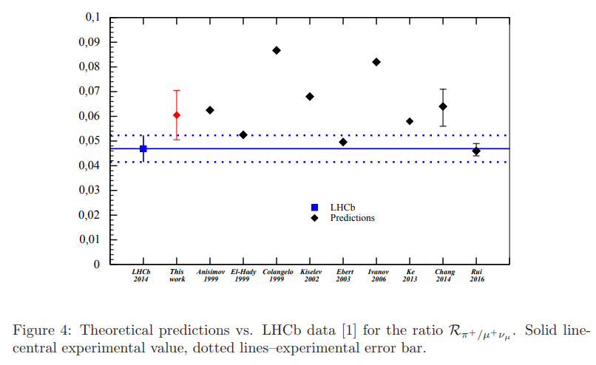
Ratios of branching fractions
*Issadykov, Ivanov, Phys.Lett. B783 (2018) 178-182

Slide 52
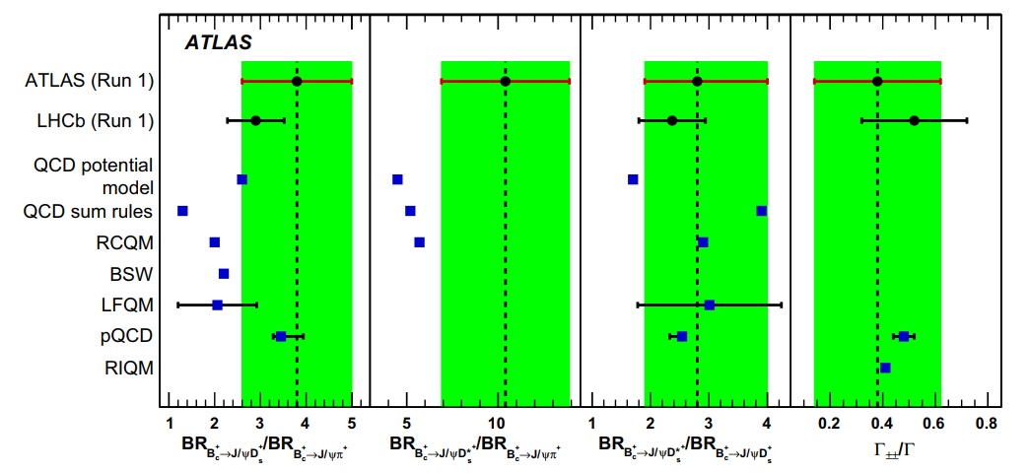
Nonleptonic decays of B_{c} meson
*G. Aad et al. (ATLAS Collaboration), Eur. Phys. J. C 76, 4 (2016).

Slide 53


Ratios of branching fractions
* Dubnicka, Dubnickova, Issadykov, Ivanov, Liptaj, Phys.Rev. D96 (2017) no.7, 076017

Slide 54

Semileptonic B_{s} →D*_{s} decay

Slide 55


Slide 56

Semileptonic B_{s} →D*_{s} decay
*Soni, Issadykov, Gadaria, Patel, Pandya, European Physical Journal Plus, 2023, 138(2), 163

Slide 57
b-c transitions
Issadykov, Ivanov, Nurbakova, EPJ Web Conf. 158 (2017) 03002
Dubnicka, Dubnickova, Issadykov, Ivanov, Liptaj,
Phys. Rev .D 96 (2017) no.7, 076017
Issadykov, Ivanov, Phys.Lett. B783 (2018) 178-182
Soni, Issadykov, Gadaria, Patel, Pandya,
European Physical Journal Plus, 2023, 138(2), 163
Issadykov, Sakhiyev, Int. J Mod. Phys. A (2023) 2350040

Slide 58

Thank you for your attention
“Ars longa, vita brevis”
Science is vast and life is short

